Slide 1





Measuring Visitor Satisfaction
Martina Brooks- User Services Manager
Rachel Ashtari – User Services Supervisor

Slide 2
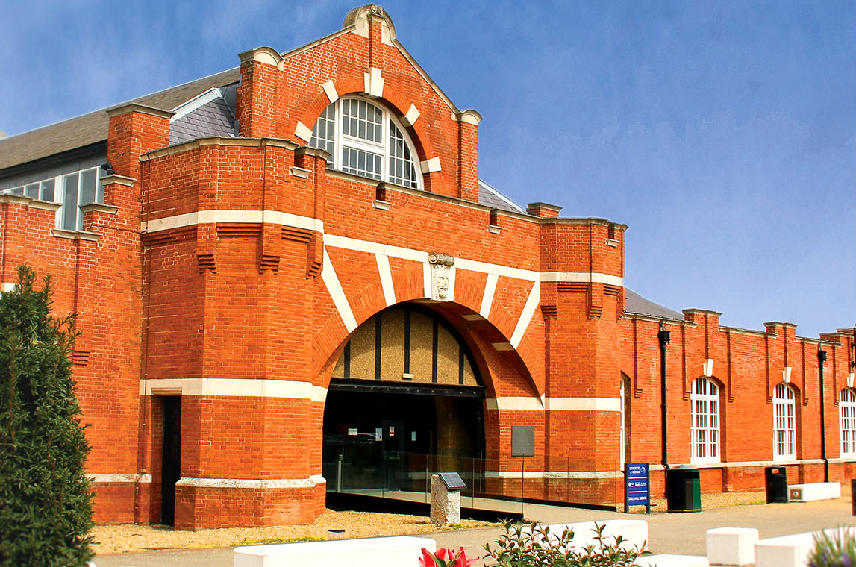



Drill Hall Background
Notes:
The Drill Hall Library at Medway may seem like a normal campus library from the outside, but it is in fact a unique collaboration of three of South East England universities:
The University of Kent
The University of Greenwich
Canterbury Christchurch University.
We manage three different collections, three different sets of library requirements and three different sets of student expectations

Slide 3
Why we measure visitor satisfaction?
To maintain high standards
Shape the future of our services
Identify trends
Identifies areas of dissatisfaction
Evidence to make positive changes
Notes:
Because of this it is important that we maintain a high standard of service expected by ourselves as well as our three university partners and we use data we collect to help us improve and mould the future of our services.
Collecting regular feedback not only enables us to monitor the overall mood of the library but it enables us to continually make improvements to our library services and resources based on what our ‘customers’ actually want.

Slide 4
How did we do it before?
Closed question surveys
Paper-based surveys
Little-used feed back mailbox
User groups that were poorly attended
NSS Survey results
Non documented feedback comments given to staff
Notes:
In previous years, we did what I expect most university library’s have done. We gave out slips of paper with various questions and asked for people’s thoughts and opinions.
We invited users to termly meetings to voice their opinions and we waited for the NSS Survey results to find out how we have performed.

Slide 5
Why did we want to change?
We needed more real-time feedback to enable us to deal with issues as and when they arose.
We needed users to tell us in their own words instead of using closed questionnaires.
We needed more supporting evidence to drive changes to improve our services and environment.
Notes:
We realised that waiting for the NSS survey results to tell us where we were falling short was very far from proactive and gave us no chance to rectify some of the minor issues that could be an easy fix, or some of the bigger issues that were really causing problems for our users.
We were slower than we should have been in making improvements and dealing with problems.

Slide 6

The Solution
Text
Notes:
We needed to a way to collect and respond to feedback, complaints and queries in real time; a one-stop shop solution to collect data using different resources already available to us.
We wanted to be able to accurately record statistics and respond to users as and when the issues arose.
Over the course of the year this would help us address any major and minor issues which would positively impact our NSS Scores.
After researching the range of what was on offer we approached ServMetric

Slide 7
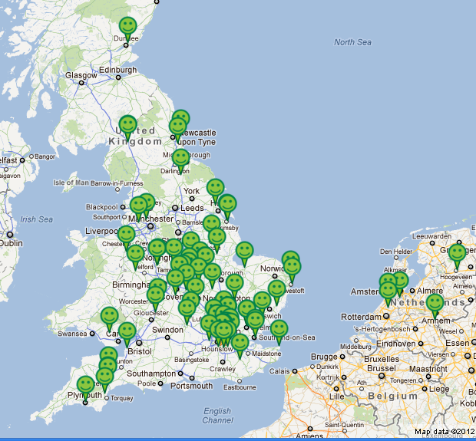
ServMetric
ServMetric as part of rol Solutions Ltd., software range is a market leader in measuring customer experience.
ServMetric and sister brand GovMetric, launched in 2006 and is the most widely used solution for capturing the ‘Voice of the Customer’ within the UK recording over since 30 million customer interactions since 2011.
Notes:
ServMetric is a software solution designed to measure the customer experience.
It allows us to ask survey type questions but whilst also giving our customers the option to provide a wide scope of verbatim feedback in their own words, positive and negative.

Slide 8
What did we do?
ServMetric went live in the Drill Hall September 2016
Since then we heavily marketed the use of the system to staff and library users
We immediately began collecting valuable data and responding to feedback
Staff and users were empowered to leave honest opinions
Feedback could be left 24/7 365 days a year
Notes:
We contacted ServMetric and they gave us an excellent demonstration of their product capability, which ticked all of our boxes.
The system could notify the selected library teams instantly if a negative comment was left, giving us the ability to respond quickly and deal with any issues.
There were several methods the system used to collect feedback and it was all measured and collated in a dashboard for us so analysing data would be quick, easy and efficient.

Slide 9
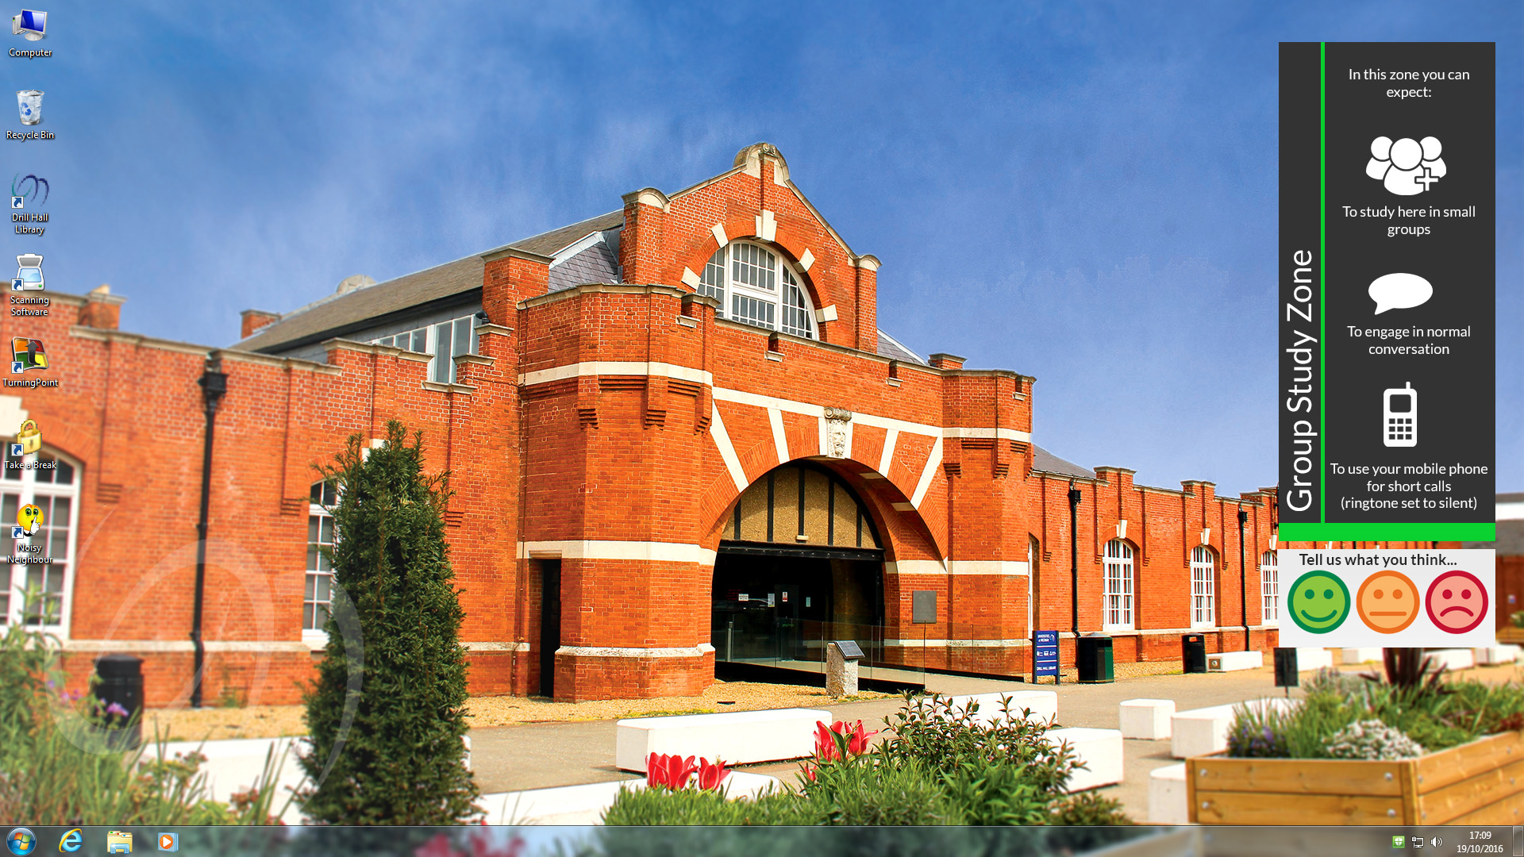
How to leave feedback
A ‘widget’ is embedded onto the PC desktop allowing the student to report issues or provide feedback
Notes:
We placed the Servmetric widget on each of our 450 desk top PC’s allowing users to provide feedback on their experiences or report issues such as noise, mess or system errors. Since we launched in 2016 the desktop widget has been used nearly 9000 times. This is a combination of a tap of a smiley to reflect their experience or to provide verbatim comments. This is our most used feedback channel.

Slide 10
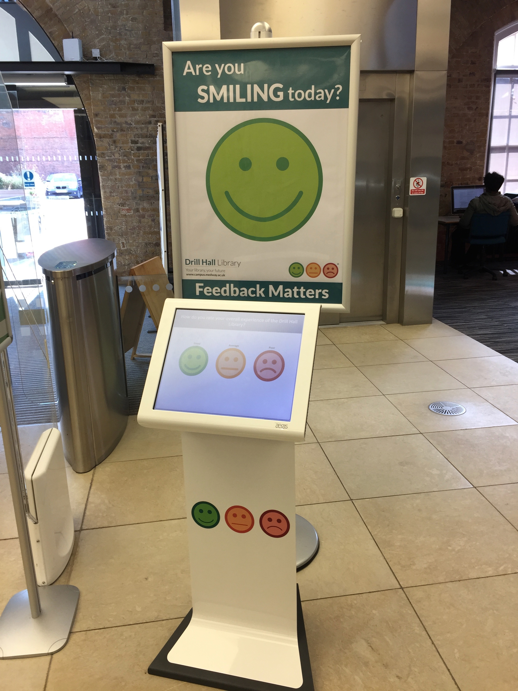
A kiosk has been placed at the exit to the library allowing visitors to provide feedback on their experience
Notes:
We strategically placed a kiosk by the exit of the library to allow all library users to provide feedback on their experience, including those who did not use a pc or worked from their own laptop. We also encourage visitors to provide feedback on their experience, such as the helpfulness of staff and was the library east to navigate.
The kiosk has been used nearly 8,000 times since the launch of the system.

Slide 11
The Smileys’ image sits on the global template of the website and allows the customer to feedback at any time
Notes:
We added a familiar smiley feedback icon to the front of the Drill Hall library webpage, allowing all website visitors to provide feedback at any time. This channel has been used nearly 500 times, making it by far the least used feedback channel, which is interesting because before Servmetric we assumed our website would be the go-to place to provide feedback.

Slide 12
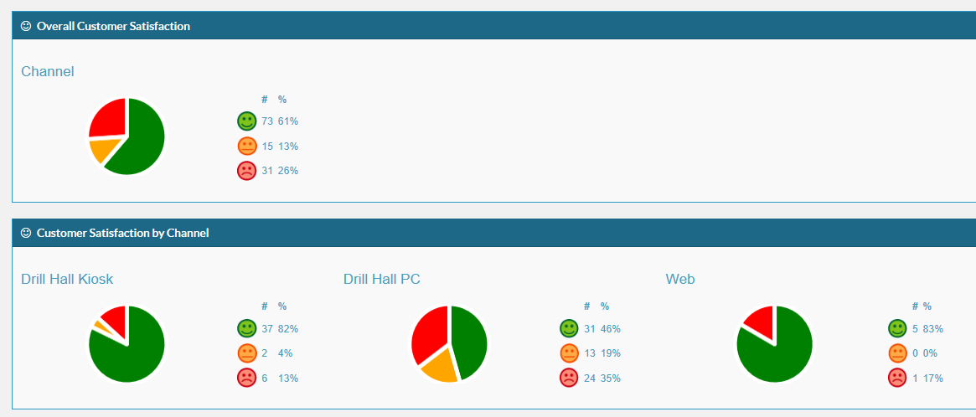
Reporting – Key Features
Simple to access and use online reporting suite including:
Dashboards
Alerts
Tracker
Notes:
One of the big draws for us was that all feedback is recorded on a dashboard and each dashboard can be customized depending on your focus. You can see here that my dashboard records overall library satisfaction broken down by channel from which it was received.
You can also create custom reports to run weekly, Monthly, annually etc which presents the feedback results in a report ready for distribution.

Slide 13
What did we learn in 2017?
11284 | 2470 | 3397
70% | 12% | 18%
Since the launch we have received feedback
from over 17,000 library users
Notes:
2016/17 was our first year of running the servMetric software and in the space of 18 months we received over 17,000 pieces of feedback, both positive and negative. But overall we could see that satisfaction in the library reached 70%.
This gave us an accurate representation of the overall ‘mood’ of the library and it was something we could compare against our partners library survey as well as the NSS.

Slide 14
Actionable Insights
Over 1,200 actionable feedback from Visitors
Issues included:
Noise or disturbance reports
Library opening hours
Equipment broken
Request for additional equipment
Building Issues – toilets, cleaning, building temperature
Signage
Notes:
Much of this feedback was quality feedback - comments our customers had made regarding our service, not only allowing us to make changes to our service where necessary but also collecting feedback to make cases to address larger scale issues such as improving the library facilities and changing opening hours etc

Slide 15
Lessons Learnt
You need to get staff buy-in to promote the use of the system as a positive thing
Positive marketing campaigns for the use of the system, quick, easy and your opinions matter and will be answered
Consistency – reply to everyone who requests a response and action changes where possible
Keep staff informed on the feedback received
Notes:
We learnt that Staff buy-in is important to encourage use of the system for all issues. We introduced and let staff play with the system well before it went live.
The use of the system still needs to marketed as a positive addition to the library through regular marketing channels
Response times should be consistent to encourage further use and trust in the system. So we have trained a number of staff who respond to feedback during opening hours.

Slide 16
Changes we have made
Improvements to library environment and facilities offered
Improved library resources available
Improved relationships with campus partners i.e. Estates dept. , Stakeholders and partners
Notes:
Evidence collected has allowed us to make changes to the timing heating system, purchase additional resources, change our opening times and improve roaming and security to better meet the needs of our users.
We have built stronger relationships with our campus partners such as facilities and estates based on the use of this system.

Slide 17
Benefits of Change
Empowering our users to make a positive change
The voice of the user is heard and evidenced
Evidence to present to partners and stakeholders on the mood of the users
Staff and Users feel they have more ownership and give weight to changes that happen
Notes:
We have seen a change in the culture of the library because users feel empowered and can see changes happening as a direct result of their feedback.
This promotes the feeling that this is ‘their library’ rather than ’a library’ so users feel they have more of an ownership of the Drill Hall and respect for the resources. We have also been able to access all feedback in one place reducing staff time spent on running feedback campaigns

Slide 18
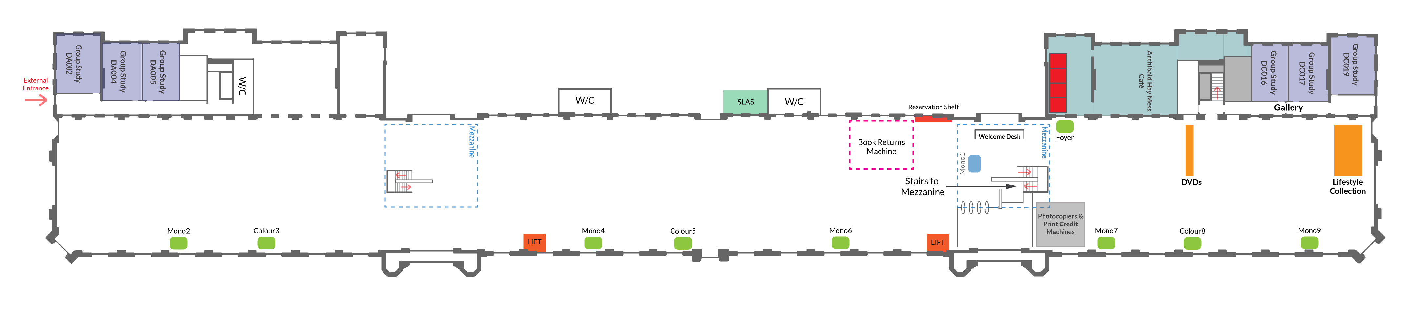
Ongoing Modifications
Notes:
We have since modified the system to notify us of the exact room or zone the feedback has been sent from, so issues regarding working environments such as noise and temperature etc can be addressed as quickly and efficiently as possible.

Slide 19

The Future
Tonbridge Library
Avery Hill Library
Templeman Library
Drill Hall Library
Stockwell Street Library
Salomons Library
Broadstairs Library
Augustine House Library
Notes:
Since the successful installation of Servmetric within the Drill Hall the evidence produced has resulted in the system now being used at two other libraries within our partnership and is currently being assessed for use by our other partnership libraries at Kent and Canterbury Christchurch.
We have recently installed a new library management system in our collaboration and we are looking into the possibility of integrating ServMetric into our catalogue.
We have found the system flexible with lots of potential and we fully intend to capitalise on this for the benefit of our users.

Slide 20
Come and talk to us for more information
Martina Brooks - M.Brooks@Greenwich.ac.uk
Rachel Ashtari – R.Ashtari@Greenwich.ac.uk
Notes:
Thank you for your time. Please feel free to contact Martina or myself if you would like to find out more about our ServMetric journey.

Slide 21
What about us?
UX = Staff 2
Regina Everitt
Interim Director, Library and Learning Resources
SOAS University of London
www.soas.ac.uk/library

Slide 22
Library staff
SOAS academic staff
SOAS students
partners
public
corporate users
External students
exec leaders
Professional Services staff
researchers

Slide 23
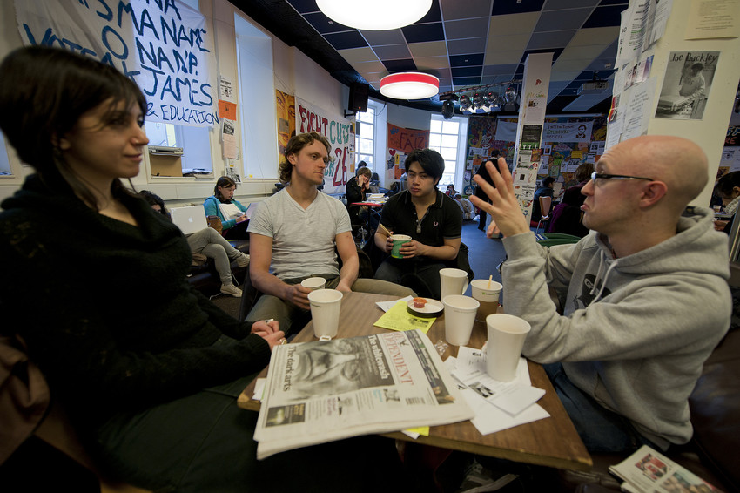
SOAS at a glance
SOAS has over 100 graduate programmes
SOAS offers an unparalleled range of non-European Languages
More than 400 degrees combinations are taught here
50% of our students are from outside the UK
SOAS has the largest concentration of specialist staff at any university in the world
Photo: G. Ratcliffe

Slide 24
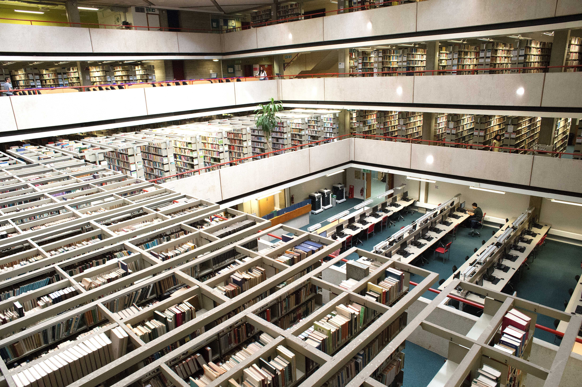
SOAS Library
One of five National Research Libraries
Over 1.3 million items, 35,000 e-journals and 100 databases
Stock is arranged by region, with several non-regional collections (e.g. Law, Art, journals and Humanities & Social Sciences)
Archives Collections
Photo: G. Ratcliffe
Notes:
Cambridge, LSE, Manchester U, Bodleian – Oxford U, SOAS

Slide 25
Innovative
Millennium
OLE
(open source)
Notes:
In April 2015, SOAS moved to an open resource LMS called OLE. Roll back to 2011 (before my time) when the time was reviewing LMS options after running Millennium since 1999. At the time Sierra was not yet developed. Like many Libraries, the team sought a solution that could manage print, e-journals, e-books, databases, on- and off-site access, repositories, digital archives and the emerging field of Open Access and Research Data Management. Ultimately, a decision was made by the team to look to open source solutions – and OLE was chosen.

Slide 26
Customer
Um, we need this….
We can release then…
Collaborator
You’re gonna
release when!?
Let’s develop
this…
Notes:
Moving to an open source system meant a culture change for staff members. They needed to move from being a customer – reliant on vendor releases for system enhancements – to collaborator, working with partners in the US to develop the system.

Slide 27
‘Management’…don’t have a clue….!!!
Notes:
There were a few challenges… This was a new way of working after more than a decade of using one system. So, staff members were navigating the ups and downs of the change curve. Staff members who were not confident using IT were frightened that they would look foolish if they did not catch on quickly. Staff who were confident in using IT didn’t think it was their job to develop a system. And of course there were some staff members who were up for the challenge of a new system.

Slide 28
OLE Day...
Self-service in operation….no on-counter duties
Populated demo system….’sandpit’
Function-focused training sessions
Floor walking by confident team members
Think-tank sessions on work flows
Coordinated load testing
Documentation drafting
Notes:
To assist staff members with their transition to OLE….

Slide 29
Implementation!!!!!
Notes:
We were the first to implement OLE in April 2015. University of Chicago and Lehigh University in America joined later. However, as the first implementing site we had a number of teething problems: slow system performance, some features not immediately implemented such as fines calculation, rogue notices being published… I will be unpopular and say that some teething pains are expected when you consider the scale of migration of nearly a million bib records and thousands of user records and transactions.

Slide 30
‘Management’…don’t have a clue….!!!
Notes:
Front line staff members felt that senior managers in the Library had no idea of the issues that they faced. Beyond the embarrassment of having users stand before them while they waited for transactions to churn through due to poor system performance and complaints about incorrect notices….did ‘management’ understand or even care how staff members’ jobs changed? But how much did staff members’ jobs change? Would they not normally flag bugs or enhancements for vendor-based systems? I wanted to understand staff experience of using the new system so embarked on a UX mini-project.

Slide 31
Staff UX
contextual inquiries
Notes:
There are a number of approaches to UX analysis. Customer journey mapping is a popular approached used by some Libraries in understand how customers use their spaces. Ethnographic studies are used to study users in their working environment. I chose to use ‘contextual inquiries’. The *interviewers used contextual inquiries to gather qualitative information about staff experience of using OLE. Contextual inquiry is an interview method where users are asked a set of standard questions then asked specific questions as they are observed performing their tasks/functions in their work environments

Slide 32
Objectives….
Staff user experience
Culture change
Resourcing

Slide 33
Approach…
Voluntary – staff of varying levels
Two interviewers – varying levels
Not about performance management
Interviewer notes anonymised
Notes high-level – not verbatim
One month period

Slide 34
Functions observed…
General circulation tasks at the counter (including self-service machines)
Claims returned management
Cataloguing (non-Roman)
Acquisitions (including purchasing, invoicing, receiving orders; discussed year-end processing)
Looking up records (non-Roman)
Lost item management
Council meetings
Reservations management (including cancellation, drop off, collection)

Slide 35
Proforma…
Anonymised
Function
Went well
Challenges
Recommendations

Slide 36
About the volunteers…
9 out of 48 daily users … 19% of eligible users
Staff-selected representation
Confident users

Slide 37
Overarching themes…
System performance
Potential of open source
Training need
Communications
Streamlining
Workflows

Slide 38
Recommendations for SMT…
Communications to support collaborative working
Technical resources
Cross-team decisions on workflows
Training
Review of job descriptions

Slide 39
Where we are now…
System performance and technical resources
Open source…user control
Confidence and training
Collaborative working and workflow design
Job descriptions

Slide 40
Staff UX
Management
information

Slide 41
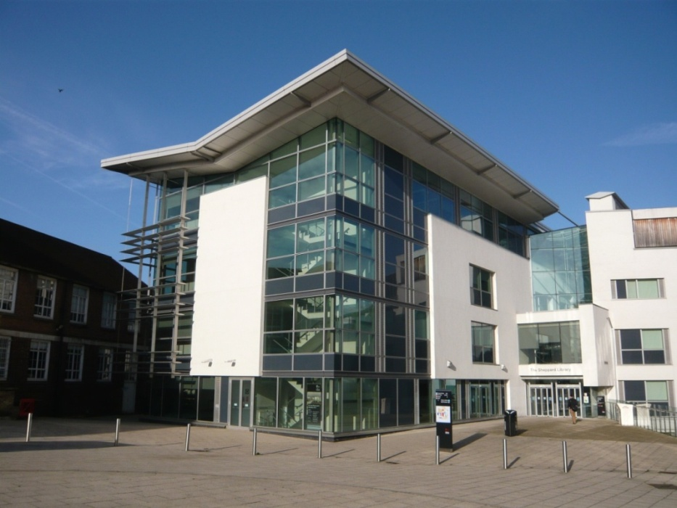

M25 Conference April 2018
Introducing the human touch to information provision:
Human Book Events at Middlesex University
Notes:
VH
I’m Vanessa and this is Monna and we’re both Librarians at Middlesex University. This is where we work.
As librarians we all think about libraries quite a bit and back in 2014 we were discussing how to encourage students to use the library……the assumption is that they will just turn up because they instinctively know that the library is important to their academic success…….obviously this is not the case.

Slide 42

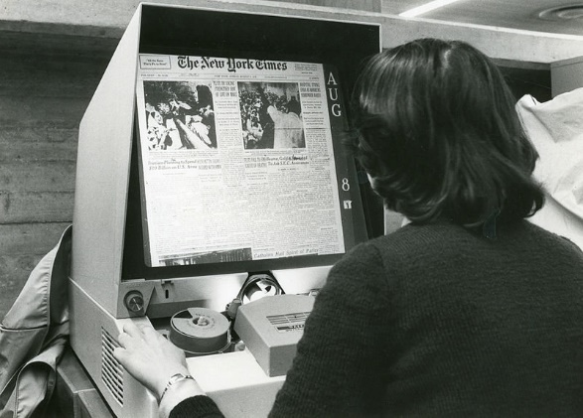
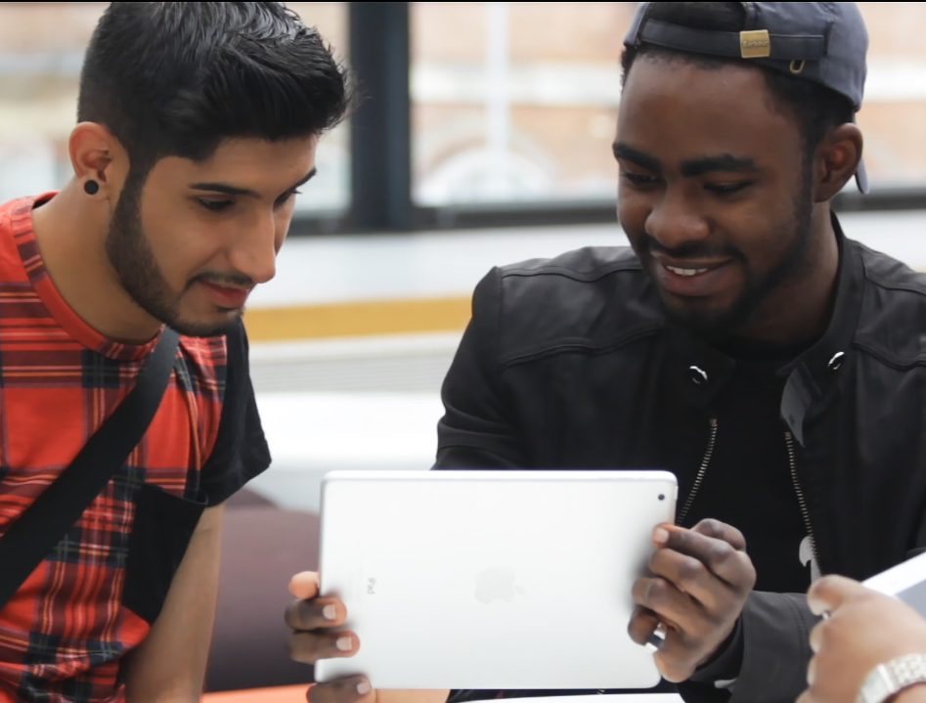
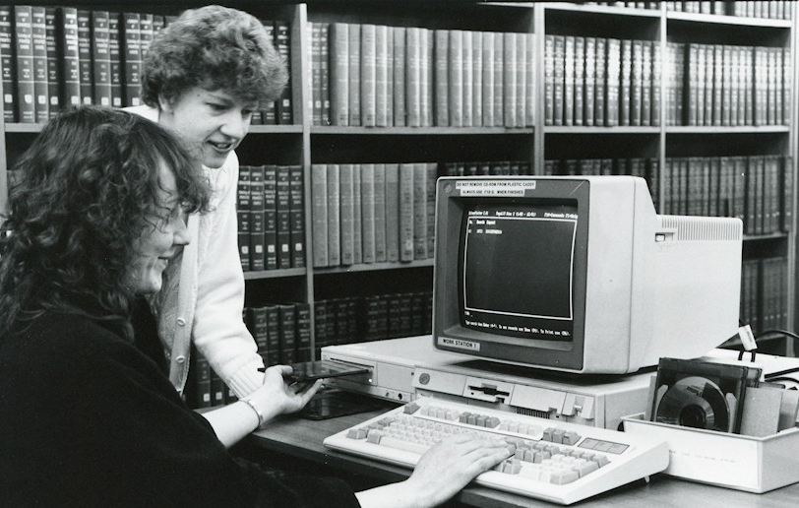
The context
Notes:
VH
Libraries and the information landscape have changed a lot.
We are no longer the Guardians of Information……our users can go it alone and don’t need us to provide information….they can access it 24/7.
Libraries have had to adapt to these changes and all have had to reconsider their role and how best to serve their users.

Slide 43
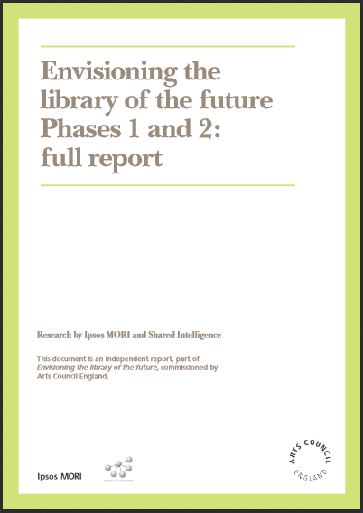


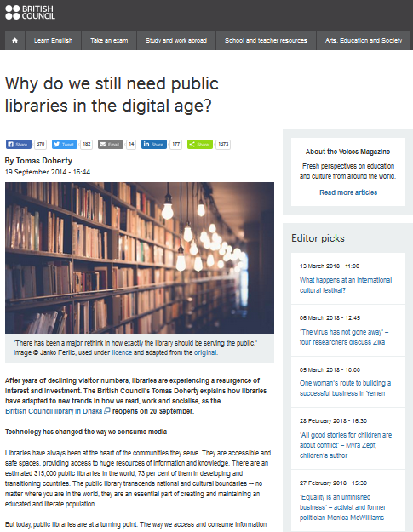
Inspiration
http://www.artscouncil.org.uk/sector-resilience/envisioning-library-future
https://www.britishcouncil.org/voices-magazine/
why-still-need-public-libraries-digital-age
Notes:
VH
The following publications inspired us. They emphasised ‘community’ as the traditional defining feature of libraries and the need for them to be the “hub of a community”………what they said resonated with us.
How do we keep the library relevant to our users and central to their academic lives?
This question got us thinking about Human Libraries.
So what exactly are they?

Slide 44
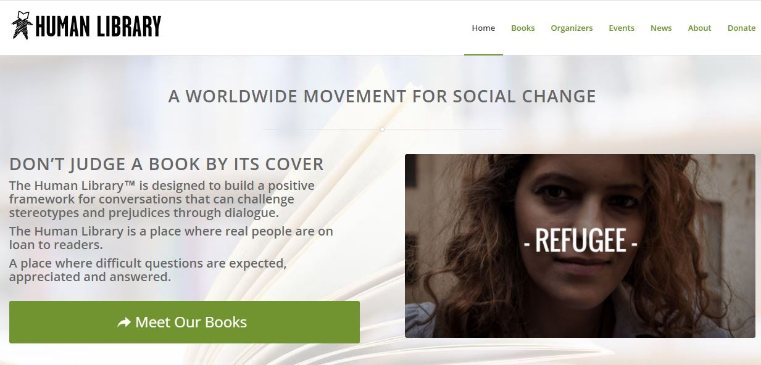
The Concept
http://humanlibrary.org/
Notes:
MR
The Human Library is a place where real people are on loan to readers. A place where difficult questions are expected, appreciated and answered.
The original event in 2000 featured over 50 different titles, over a thousand readers and between them challenged stereotypes through dialogue, demonstrating the incredible impact of the Human Library.

Slide 45
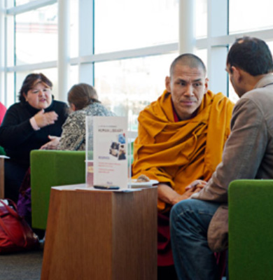
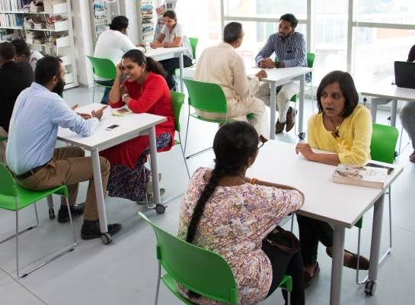
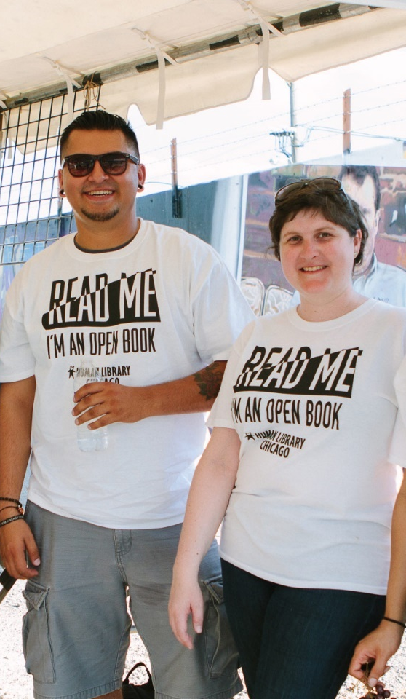
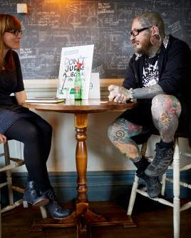
Homeless
Refugee
Unemployed
Religious Group
Young single Mother
PTSD
ADHD
Autism
Mental Health issues
HIV
Sexually abused
Drug/alcohol dependent
Lifestyle choice
Sexual orientation
Image/appearance
Notes:
MR
The concept has since been adopted internationally and public libraries have been at the forefront of the movement.
The books are people with a story to tell who are generally stigmatised, misunderstood, controversial or on the edges of society.
The possibilities are endless as can be seen from this list.
So why did we think the Human Library concept might work for us?

Slide 46
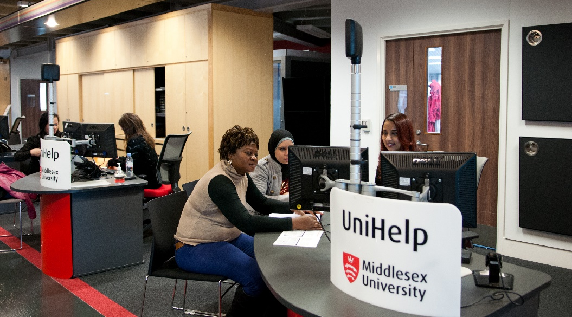
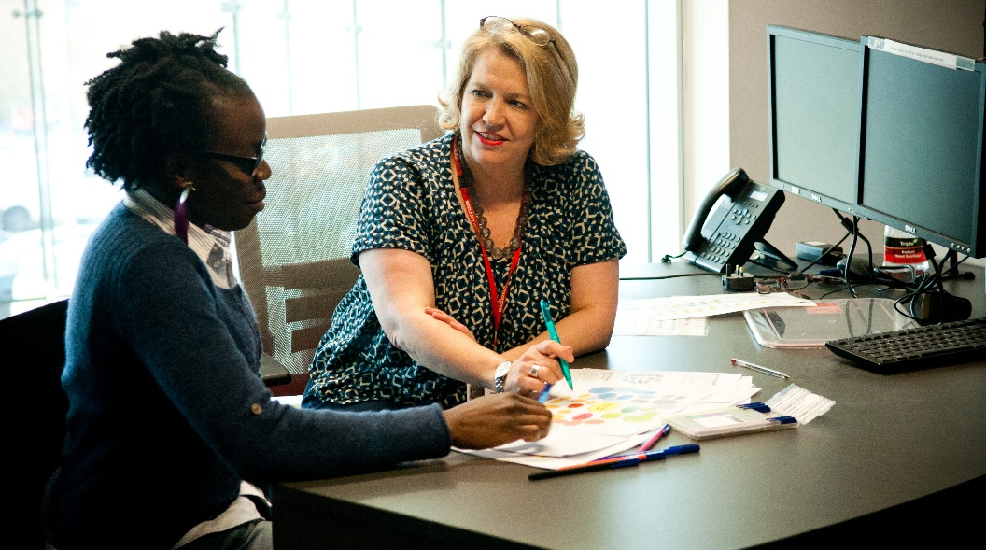
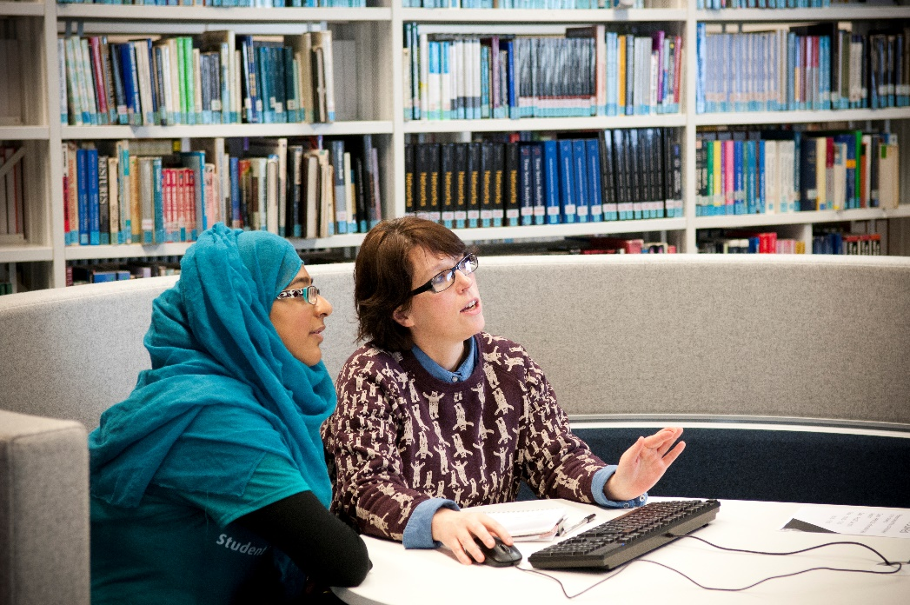
Library and Student Support (LSS)
Academic Writing
Counselling and Mental Health
Disability
Finance
International Student Advice
IT
Library
Maths and Stats Support
Student Welfare
Notes:
MR
Over the last few years our Library service has expanded as we have been joined by a broad range of student support services from around the university to form what is now known as Library and Student Support.
We felt that Human Books with real life experiences could act as a link between the help, support and advice available from the library and student needs and promote our service as central to student life.

Slide 47
Making it happen..
Strategy Refresh
The People and Culture strand
Human Book Event
Finding new ways of putting students at the centre of everything we do
Recognising that the diversity of our students and staff is an incredible resource
Books are people, and reading is a conversation
Notes:
VH
We put our idea to the Library executive and then to the wider University.
Nothing happened for a few months until the introduction of our University’s new strategy which included a ‘Culture and people’ strand.
Our Business School offered to pilot a Human Library event where the books were Middlesex Alumni from the business world.
This was not quite what we had envisaged, but it allowed us to try out the concept.

Slide 48
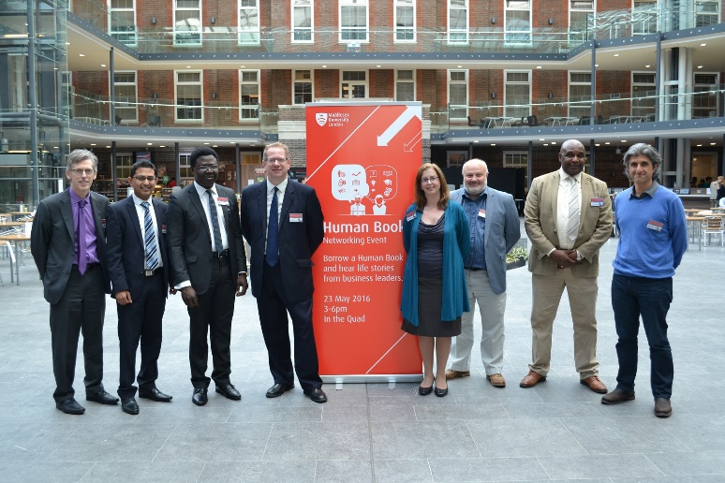
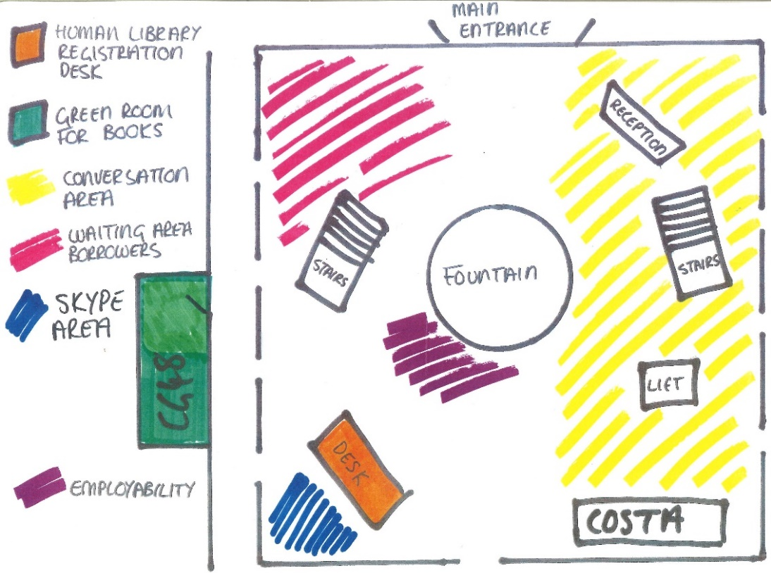
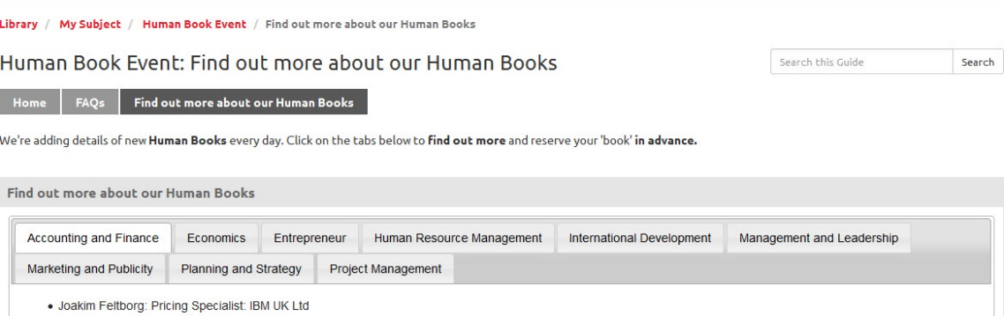
..and it happened!
Notes:
VH
The event was held on 23rd May 2016.
Although based on the Human Library concept we had to change the name to Human Book Event as the creators of the original concept are rightly protective of it.
Here’s a rough plan of the event layout……how could it fail!!
We used Springshare’s LibGuide and room booking software to promote the event, provide information about our books and enable online booking in advance.

Slide 49
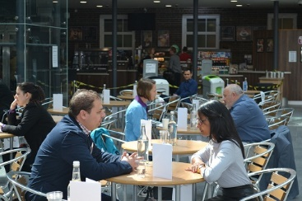
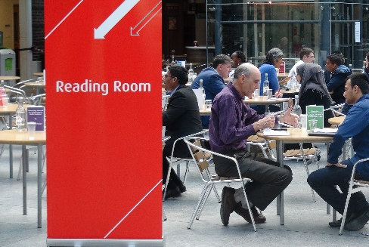
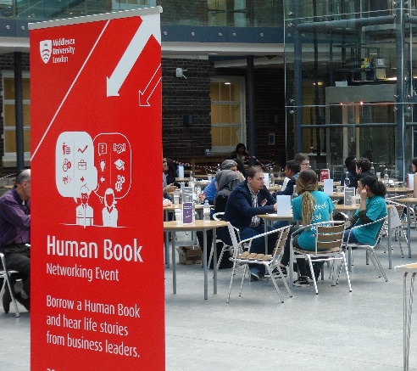
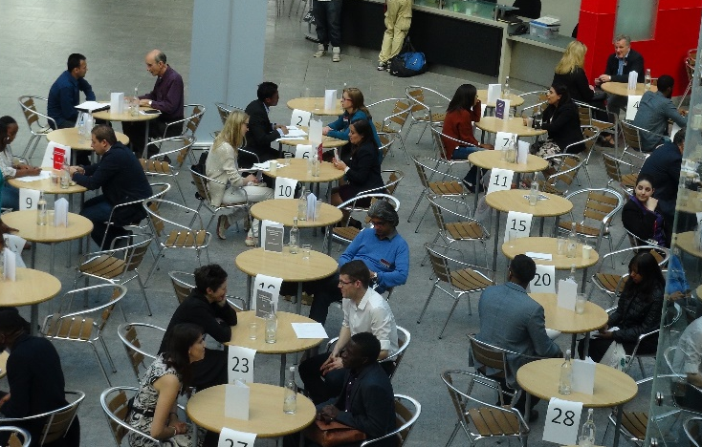
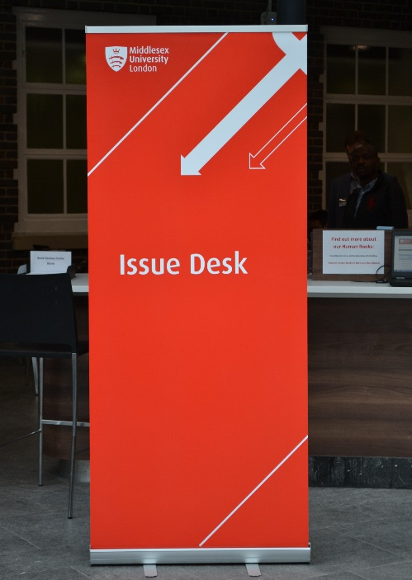
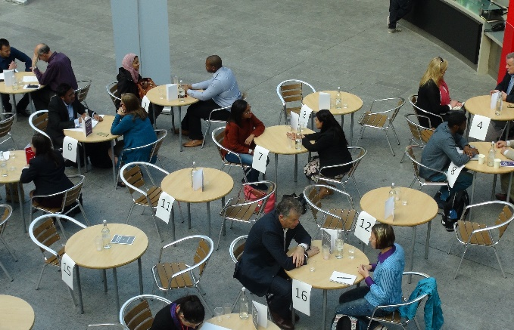
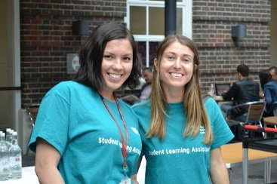
3 Hours
81 Readers
149 Conversations
43 Books
3 eBooks
33 Librarians
Notes:
VH
Here are a few stats. All the panic, sleepless nights and hard work were worth it.
Over 3 hours, 81 students had 149 conversations with 43 books including 3 ebooks which were conversations via Skype with Human Books based abroad.
33 colleagues mainly from LSS including Student Learning Assistants managed the event working as Librarians.

Slide 50
It worked….evaluation
89%
Information gained - useful / very useful
Overall experience – good / excellent
Interested in attending future Human Book events – yes
94%
92%
Notes:
VH
And it was a success…..the numbers speak for themselves.
It was also interesting to know why students had chosen to borrow specific Human Books.
Many chose books related to their course, career path, or because they were interested in a particular company.
Others wanted to challenge their perceptions, start up a business or were interested in a particular aspect of a book’s career such as charity work or working in Africa.

Slide 51
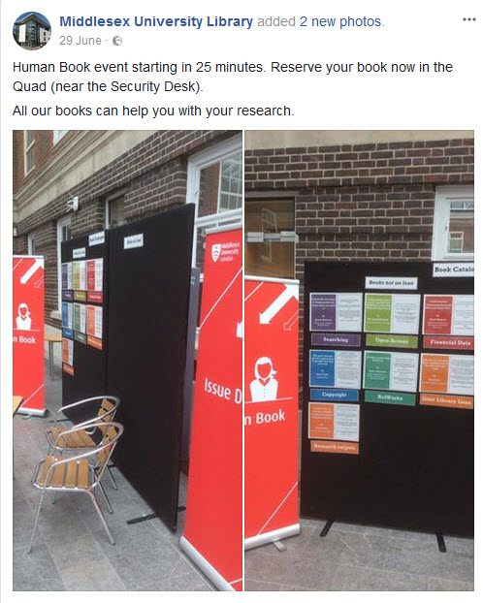
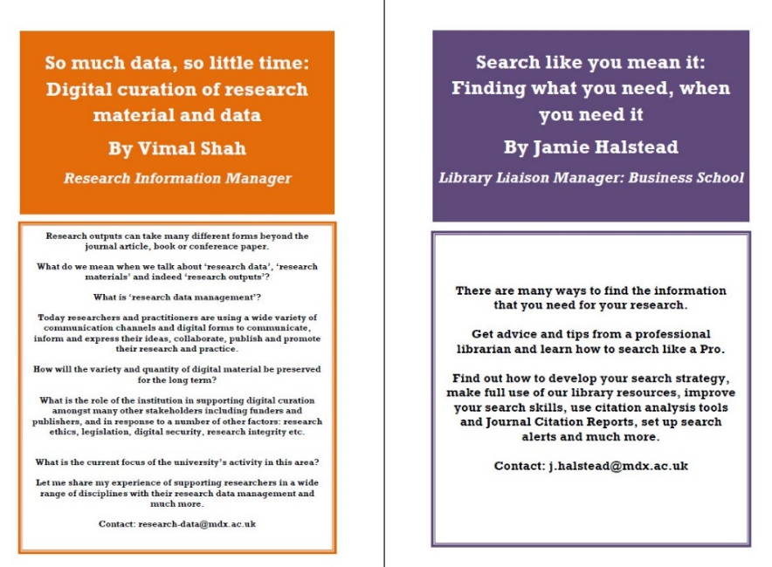

And there’s more
Notes:
MR
We have held 3 subsequent Human Book Events.
The first of these was much easier to manage. There was no online guide, no online booking and only a couple of weeks to arrange, so less time to panic.
This event was part of the annual Research Conference and the books reflected relevant expert advice and resources and was much more effective than our approach in previous year at the same event.

Slide 52
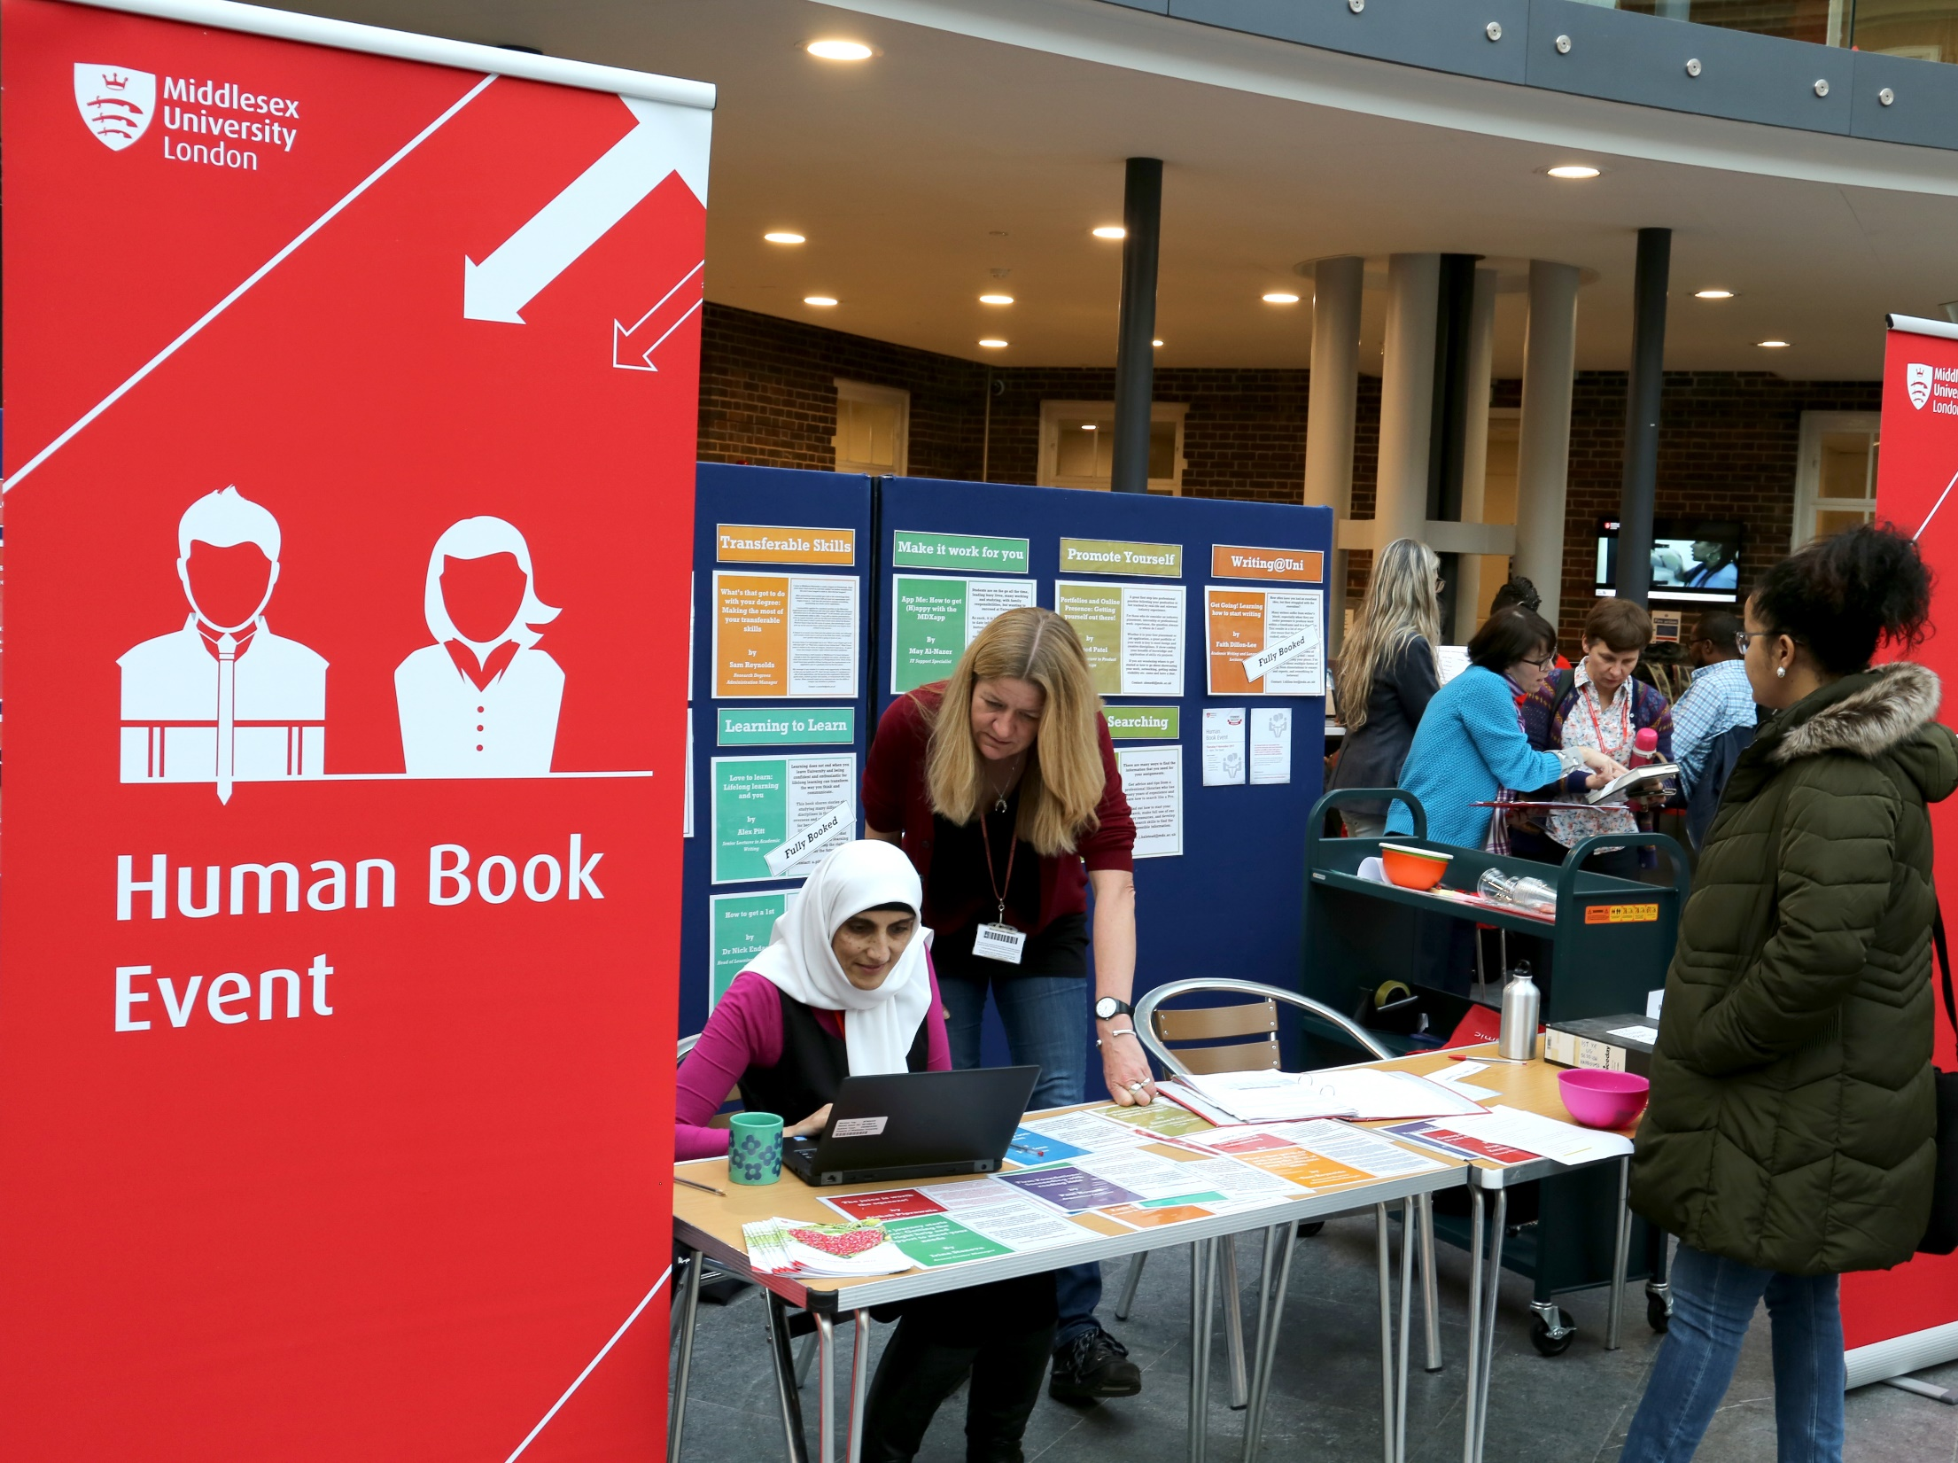
Notes:
MR
The last two Human Book Events have been part of a general Student Success Festival held most recently in March.
Our books reflected the wide ranging support available from LSS to help students succeed.
This is more like our original concept of linking student needs with library services.

Slide 53
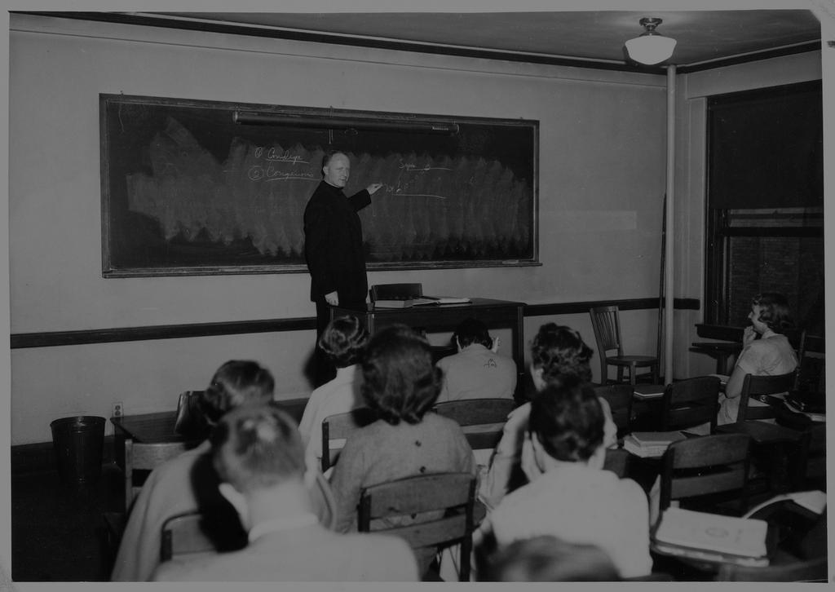
Lessons learnt
Misunderstood
Timing
Notes:
VH
We’ve learnt a few lessons along the way:
The concept is misunderstood and student feedback suggests that we should change the name. Therefore promotion is key.
Students and staff are not on campus every day and other factors such as holidays, exams, and reading weeks means that there is never a good time to run a Human Book Event in a University even though there is a lot of interest.

Slide 54
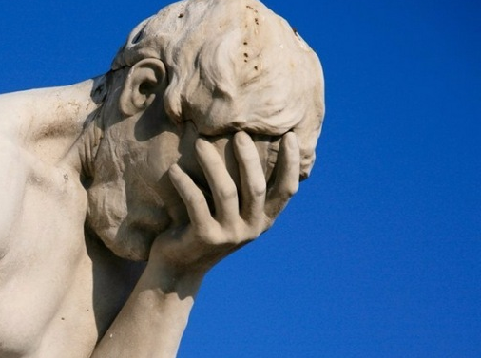
More lessons learnt
Logistics
Advanced bookings
Timing
Notes:
VH
Such events take a lot of planning and staff time to ensure that everyone is in the right place at the right time and the event runs smoothly.
Advanced bookings don’t work. Students book but don’t always turn up for their appointment.
The events are staff intensive……from recruiting the books, creating the publicity to actually running the event. Ideally one librarian is needed for every 2 books to make the event run smoothly.

Slide 55
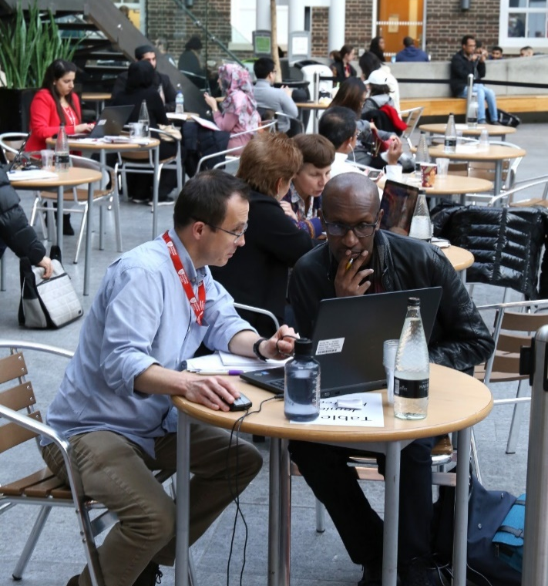
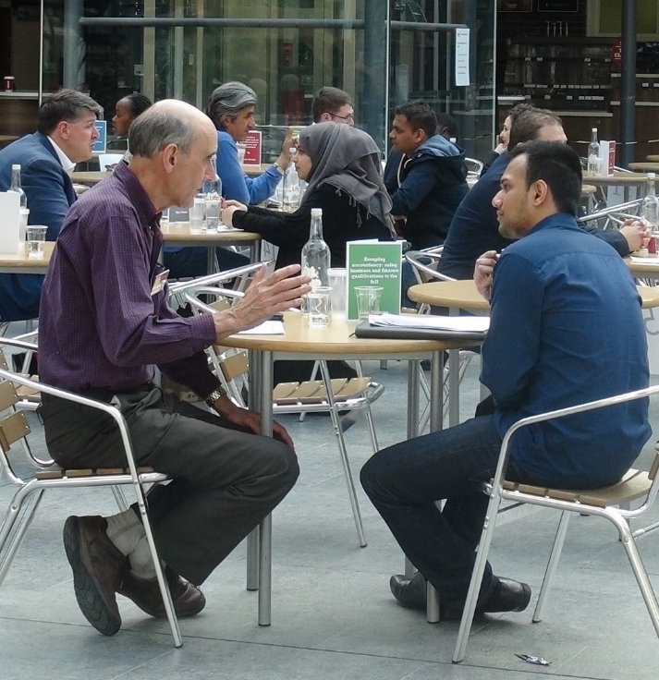
“I found the questions engendered a level of reflection and emotion in me which I did not see coming.”
“Powerful and lovely but heady in the moment.”
“The whole thing is such a positive experience for students.”
“Readers seemed very pleased with the information I was able to give them, so it felt very worthwhile.”
“It is always useful to get out there and talk to as many students as possible, whatever their prior level of knowledge about the subject.”
Notes:
MR
However Human Book Events do work. They provide an alternative to accessing support in more traditional ways.
Real conversations happen and some of the books actually followed up conversations by sharing further information with their readers.
These quotes reflect how our Human Books have found the experience to be worthwhile, powerful, positive, emotional and valuable.

Slide 56
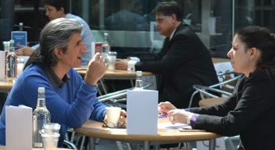
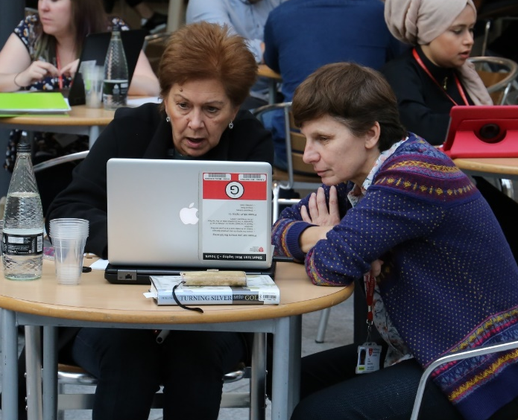
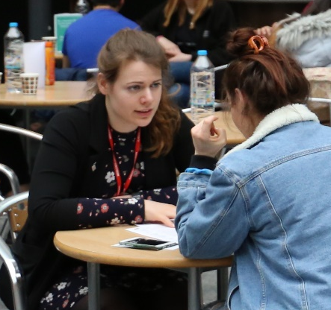
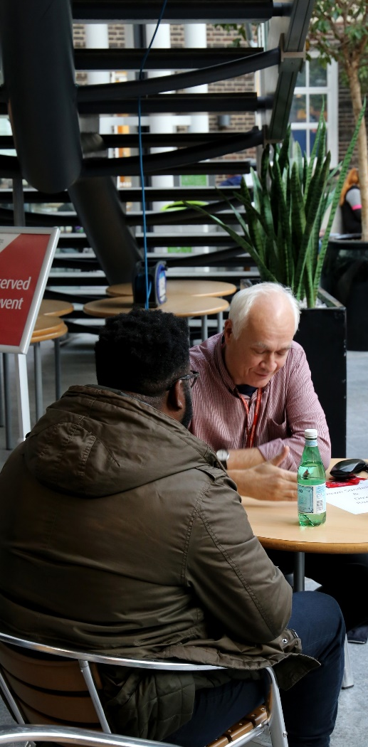
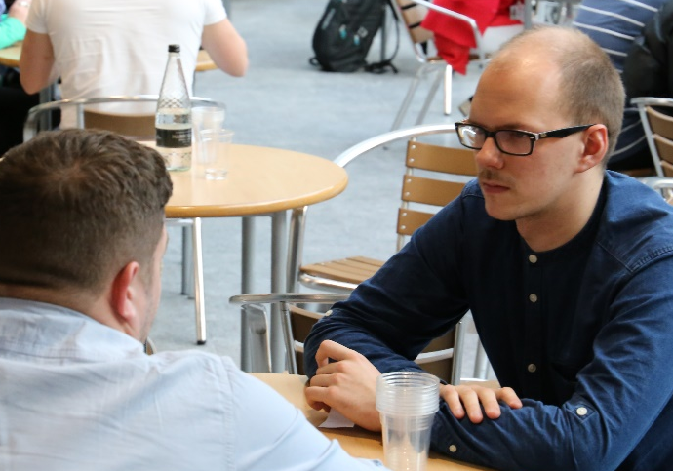
“It was brilliant”
“Everything was fantastic!”
“Great service”
“Very helpful and useful service”
“[The Human Book] was very knowledgeable”
Notes:
MR
From the Readers perspective the feedback has been equally positive.
Readers said:
It was brilliant
Everything was fantastic!
Great service
Very helpful and useful service and…..
[The Human Book] was very knowledgeable

Slide 57

Ideas
Speed Dating
Human Books on Library Catalogue
Embedded in the curriculum
http://bit.ly/HBALibrary
University of Alberta
Notes:
VH
We continue to have ideas around how to address some of the issues encountered so far. These include:
Adding our Human Books to the Library Catalogue to build on the experience and further promote our services to users.
Using a Speed Dating model might alleviate the need to take bookings and reduce the numbers of staff to run the event.
Attendance might be improved by embedding Human Books into the curriculum as inspired by the University of Alberta.

Slide 58

More ideas
Mental Health Awareness
Role Models
http://bit.ly/HBRoleModels
Strathclyde University
Notes:
VH
We’ve also had ideas around how to develop the concept including:
Running a Human Book Event as part of Mental Health Awareness Week…….a great way of promoting relevant support available from our service.
Also using Human Books to inspire young people from disadvantaged backgrounds who lack information and role models as inspired by research carried out at Strathclyde University on widening access to HE.

Slide 59
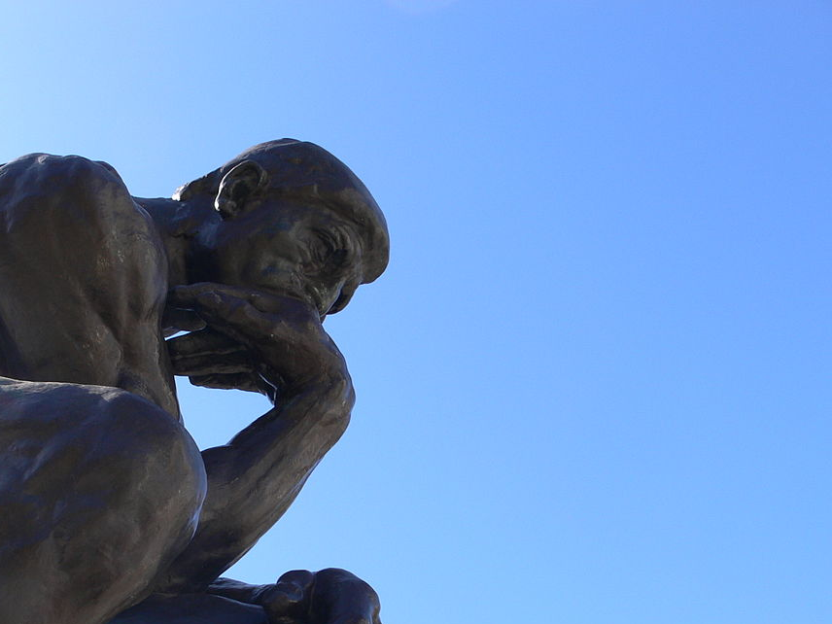
Even more ideas
Resource specific: NVivo
Festival of Learning
https://commons.wikimedia.org/wiki/File:SF_Legion_of_Honor_Thinker_2.jpg
https://www.festivaloflearning.org.uk/
Notes:
MR
Another idea is resource specific Human Book Events. For example we are considering an NVivo event where people with a unique project can talk to an NVivo representative….getting more from it than a normal workshop.
Finally Human Books on different hobbies, so a University wide Festival of Learning might be an option. This could also be opened out to the local community offering master classes, the opportunity to learn something new and to see what goes on in their local Uni.

Slide 60

Monna Rizvi m.rizvi@mdx.ac.uk
Vanessa Hill v.hill@mdx.ac.uk
Thanks for listening
Notes:
MR
There isn’t time to tell you everything we would like to, but we are happy to take questions this afternoon or via email.
Thank you very much for listening.

