Slide 1
EXCELLENCE IN ENGAGEMENT: THE ESSEX 10-STEP PROGRAMME TO TRANSFORM USERS INTO PARTNERS
Emma Wisher and Stephanie Gibson

Slide 2
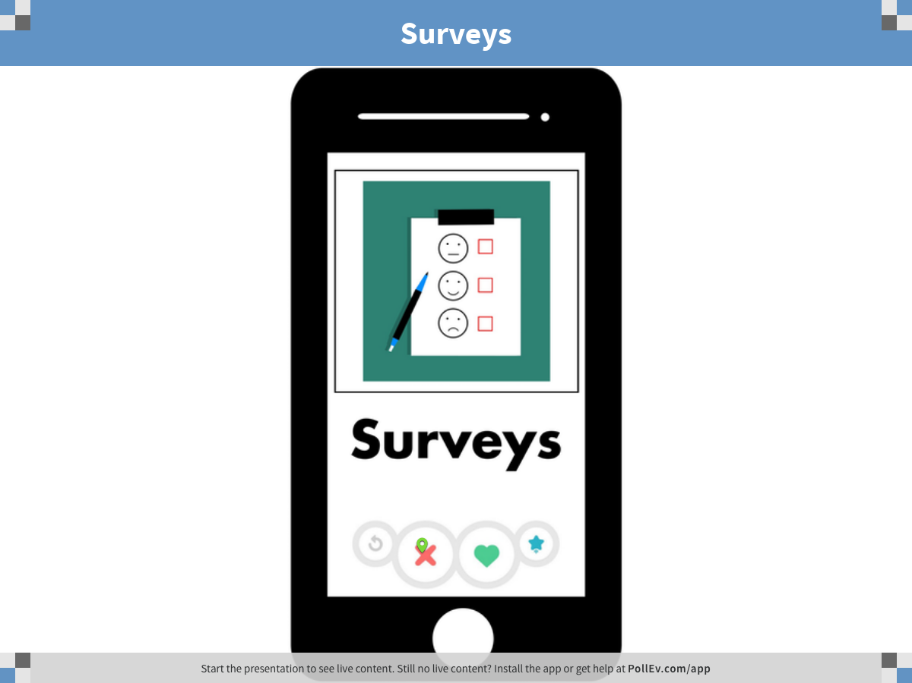
Notes:
Poll Title: Surveys https://www.polleverywhere.com/clickable_images/5pz5s8n2WuNHwGA

Slide 3
Notes:
Poll Title: Focus groups https://www.polleverywhere.com/clickable_images/j1UGOeK6i4X3O1p

Slide 4
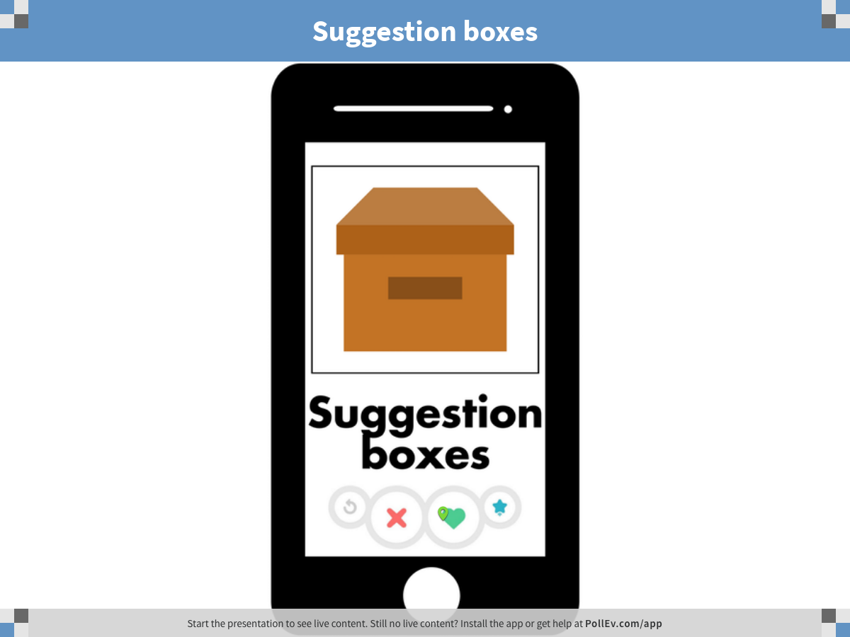
Notes:
Poll Title: Suggestion boxes https://www.polleverywhere.com/clickable_images/UltEuDeggT35Cz0

Slide 5
Notes:
Poll Title: Formal committee meetings https://www.polleverywhere.com/clickable_images/Ipg59WoUBFlu3FL

Slide 6
1. GET RID OF YOUR OLD LIBRARY COMMITEE

Slide 7
2. IDENTIFY YOUR KEY THEMES

Slide 8
3. GET STAFF ON BOARD

Slide 9
4. PICK A SNAPPY TITLE

Slide 10
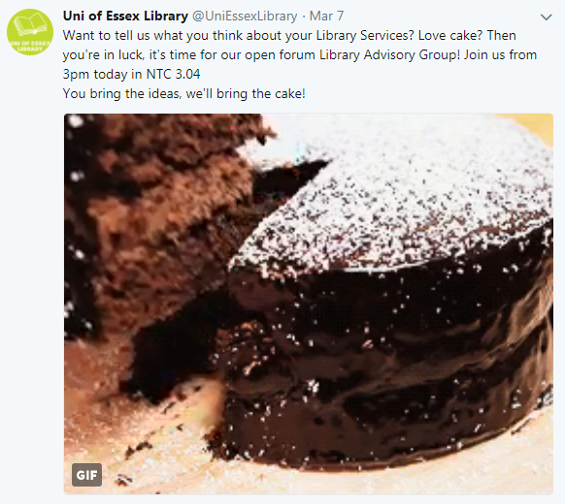
5. FIND YOUR AUDIENCE AND SELL IT TO THEM

Slide 11
6. PLAN YOUR ACTIVITIES

Slide 13
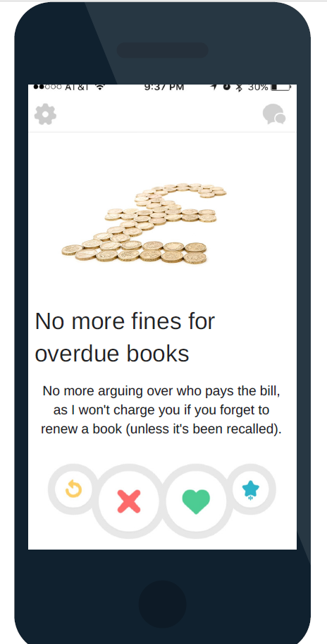
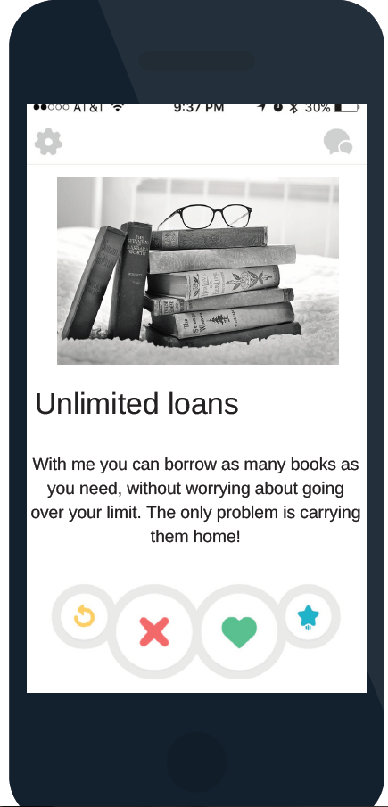

Slide 15
7. ORDER CAKE

Slide 16
8. DO THE THING

Slide 17
9. REFLECT AND RESPOND

Slide 18
10. AND REPEAT

Slide 19
USERS = PARTNERS?

Slide 20
ANY QUESTIONS?

