Slide 1
As You Like It: Translating student feedback into the design of the new library building
Matthew Brooke and Helen Rimmer

Slide 2
Background
Royal Holloway College and Bedford College merged in 1985
Bedford Library opened in 1993 – phase 1 of a two phase building. Designed to serve a student population of 2,700
Plans for an extension rose and fell 2002-2005
New Principal appointed 2010
Project resumed in 2011
Feasibility study 2012
Council approval to proceed given March 2013. Student population now 8,703. New building intended to be open for the 2015/16 academic year.
September 16th 2017: Emily Wilding Davison Building opens! (Student population 9,256...)

Slide 3
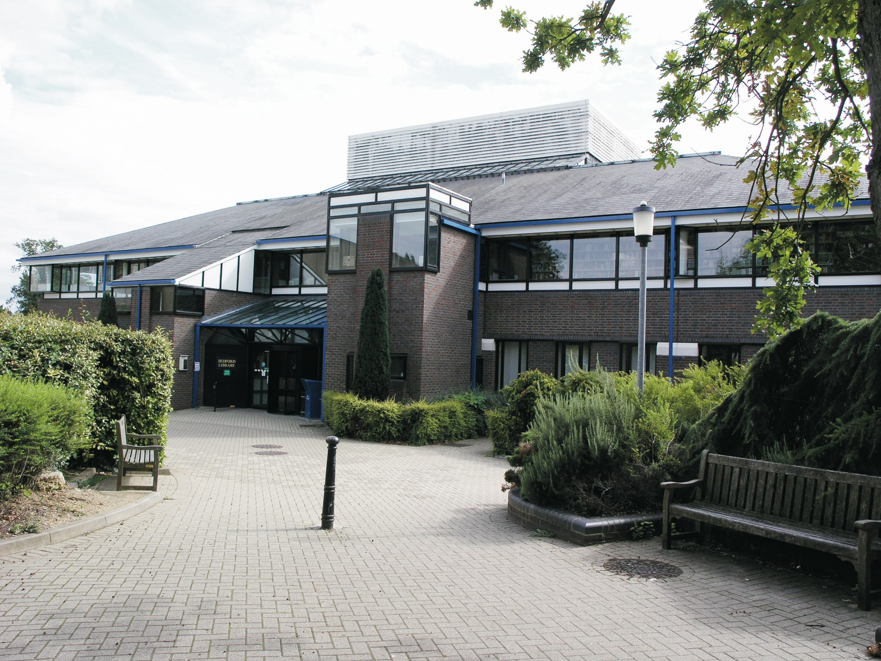

Slide 4
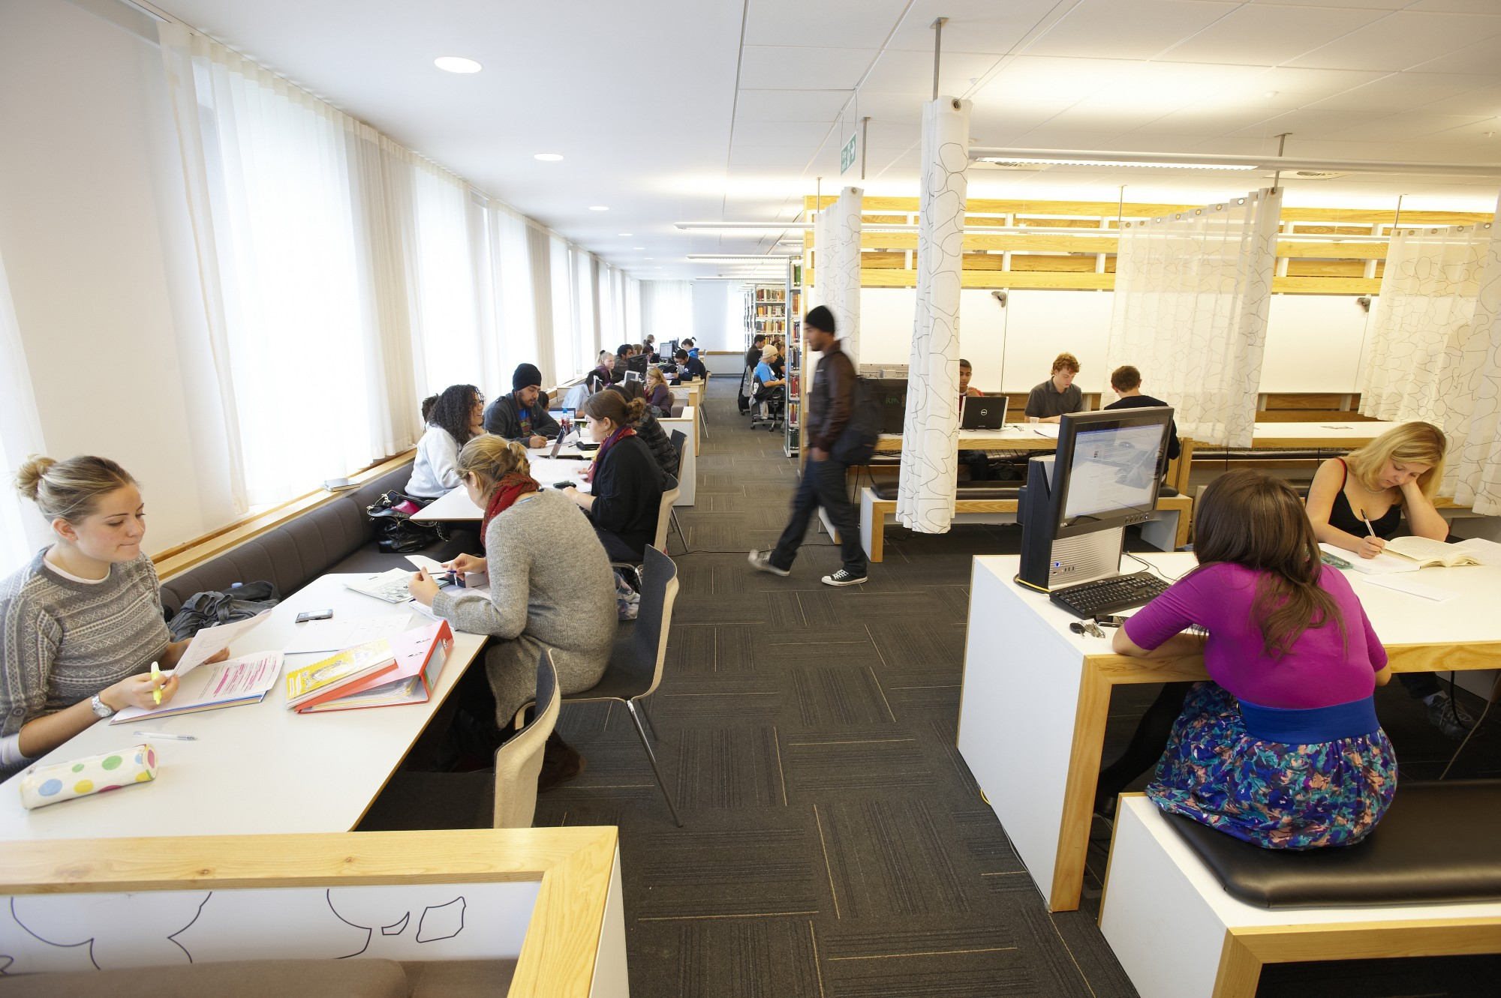

Slide 5
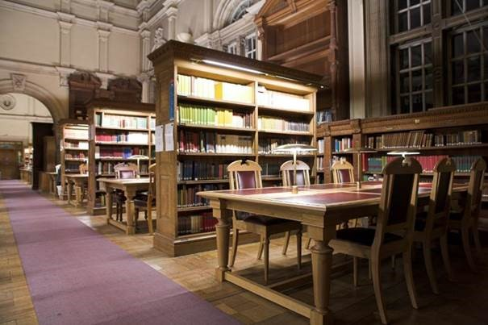

Slide 6
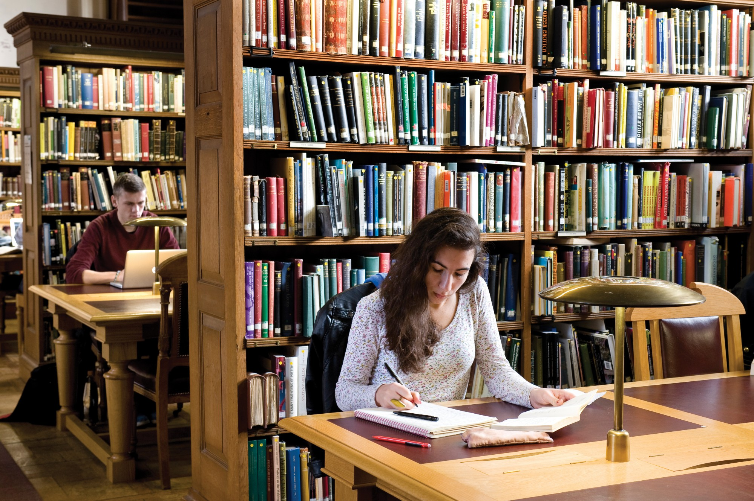

Slide 7
Background
Royal Holloway College and Bedford College merged in 1985
Bedford Library opened in 1993 – phase 1 of a two phase building. Designed to serve a student population of 2,700
Plans for an extension rose and fell 2002-2005
New Principal appointed 2010
Project resumed in 2011
Feasibility study 2012
Council approval to proceed given March 2013. Student population now 8,703. New building intended to be open for the 2015/16 academic year.
September 16th 2017: Emily Wilding Davison Building opens! (Student population 9,256...)

Slide 8
Feasibility study

Slide 9
2011 Student and stakeholder meetings - informing the brief
What is your vision of a new library?
What do you hope the project achieves in the short and long term?
Where should the library be located on campus?
What are your views on the design appearance of the new library and the historic context? Should it respond to the past or look to the future?
How important is the integration of artwork into the library?
What do you feel the library should showcase in terms of sustainability?

Slide 11
Student and Stakeholder feedback
Accessible & impossible to miss
Fit in with Royal Holloway - the beauty of its campus
Bigger & more spacious
A quality look and feel should be created so people respect the space
No more than 1/3 for group study
The café should be adjacent not in the library
Compact shelving is okay as long as it isn’t too heavy. Would still like to see plenty of open shelving
Comfortable working space less chairs and benches without backrests
Can you provide internal green space, an indoor wood
Relaxing space bring the campus landscape indoors
Green roofing was put on the residences this is a good idea
Vending machines should be provided for drinks throughout the 24hr opening

Slide 12
Student meetings – developing the brief
Three focus groups in 2013 :
Undergraduates and Post-Graduate taught
Post-Graduate Research
Disabled students
Ongoing consultation throughout the design stages:
Library Users Advisory Group
Staff Student committees

Slide 13
Student feedback 2013
Plenty of natural light in to the spaces
Silent study areas should be defined by their aesthetic similar to how on entering Founder’s reading room you understand it is silent study
Lockers and charge points.
Layout and zoning of areas looks sensible.
Water dispensers to be incorporated on all levels.
Glass bubble pod meeting spaces.
Plenty of natural light in to the spaces
Student life about mixing of levels and peer to peer learning so total segregation of PGR/UGR students not a good idea. (UG feedback)
Important to offer a degree of separation between post-graduate students and undergraduate (PGR feedback)
Would be better to have own library hub (printers etc) rather than share a series of resource points. (PGR feedback)

Slide 14
Staff visits
BCU Curzon Library
Birmingham Public Library
Cambridge
Freiburg
Exeter Forum
Greenwich University Library
Kings College London
LSE
Manchester Learning Commons
Senate House
Sheffield Diamond Building
SOAS
St Mary's Naylor Library
University of Hull
Edward Boyle Library, University of Leeds
Laidlaw Library, University of Leeds
University of Sussex
University of Warwick
University of West London

Slide 15
Staff visit to Broadstock showroom

Slide 16
Student Furniture Testing

Slide 17
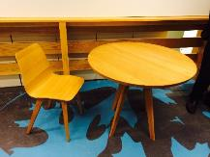
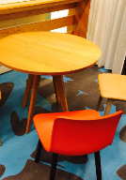
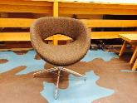
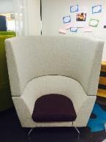
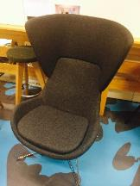
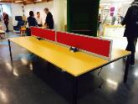
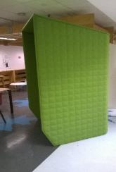
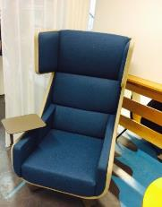
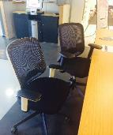
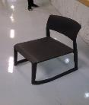
Student furniture testing

Slide 18
BuzziBooth
I WANT YOU!!!
Yes! This is crazy! Would make a lot of sense in this uni!
When I feel crazy thoughts a comin’, now I have a space to calm down
It looks silly and reminds me of a toilet cubicle
I like it. It means I don’t have to look at people and can indulge my misanthropy
It looks like the solitary confinement cells of an 1880 pentonville prison, but in Green
Love it! Especially the silent space (green thing) as I am such a fidgeter, it would mean I don’t distract others.

Slide 19
Dark Grey Chair
I like them. They are cosy. But hammocks would be better. Love hammocks.
Had ergonomic orgasm; is it meant to be permanent pleasure?

Slide 20
Big comfy chair that also has a winning desk! Great for filling out furniture survey form!
I have a been expecting you Mr. Bond *strokes cat*

Slide 21
General feedback
I want hammocks! For all nighters
Hammocks are so necessary
Microwaves won’t hurt anyone
Instead of buying expensive chairs, university should invest in our core Textbooks!!
I LIKE the leg rests! Definitely needed!! (These “leg rests” are our current mini stools from the Tea House on Level 2, Bedford Library!)
I want a bouncy castle!
Every time I visit Bedford Library to study, all the desks are taken and
computers! There needs to be more furniture and space to study and for group work.
STRIP(P)ERS is the only thing this library lacks.

Slide 22
Atrium Furniture

Slide 23
Colours

Slide 41
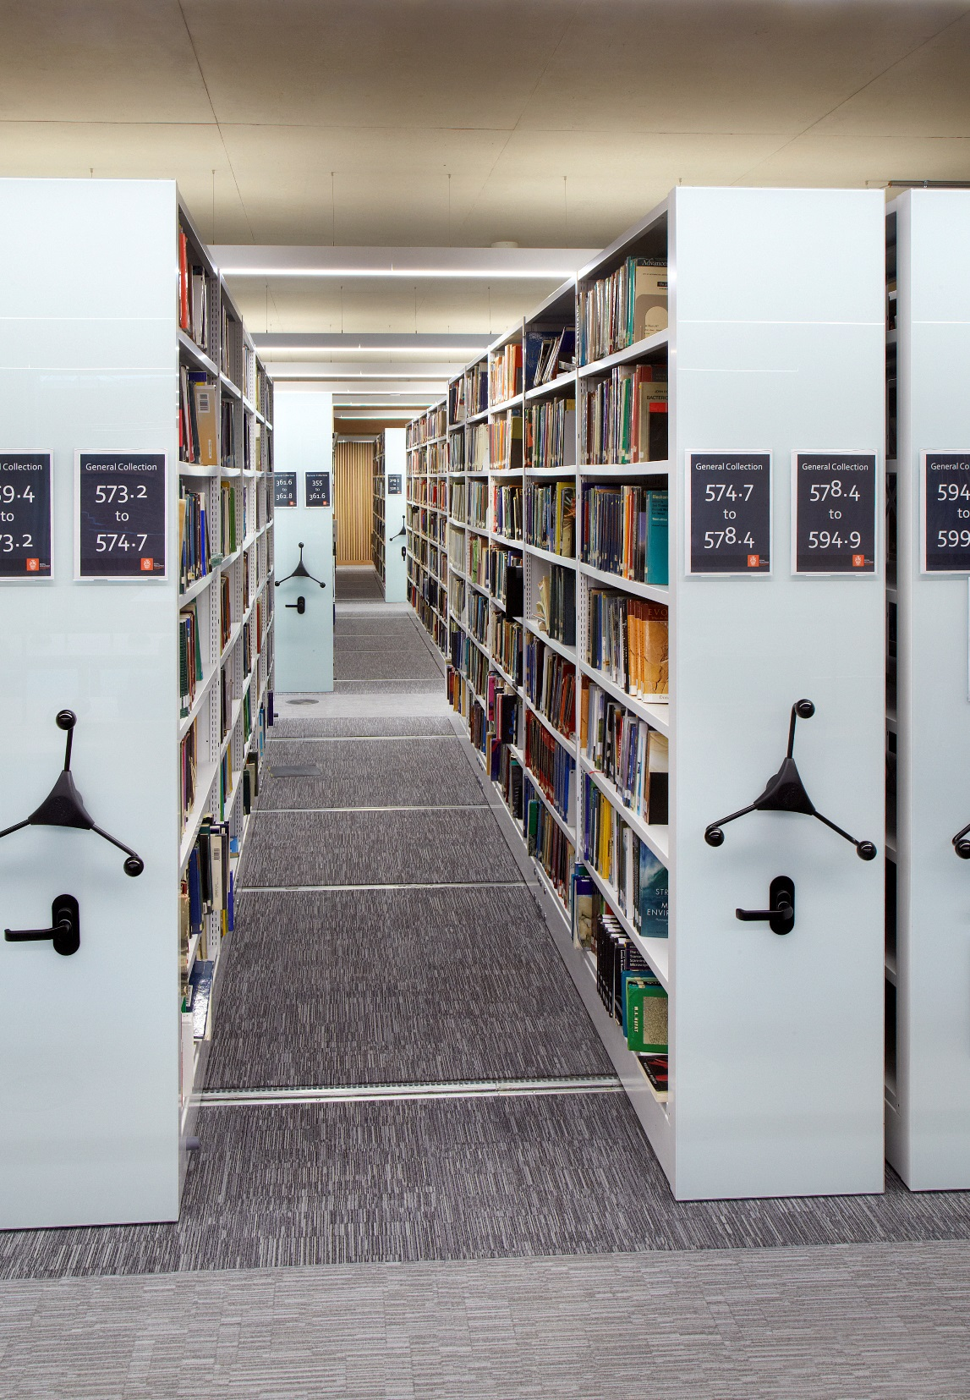

Slide 42
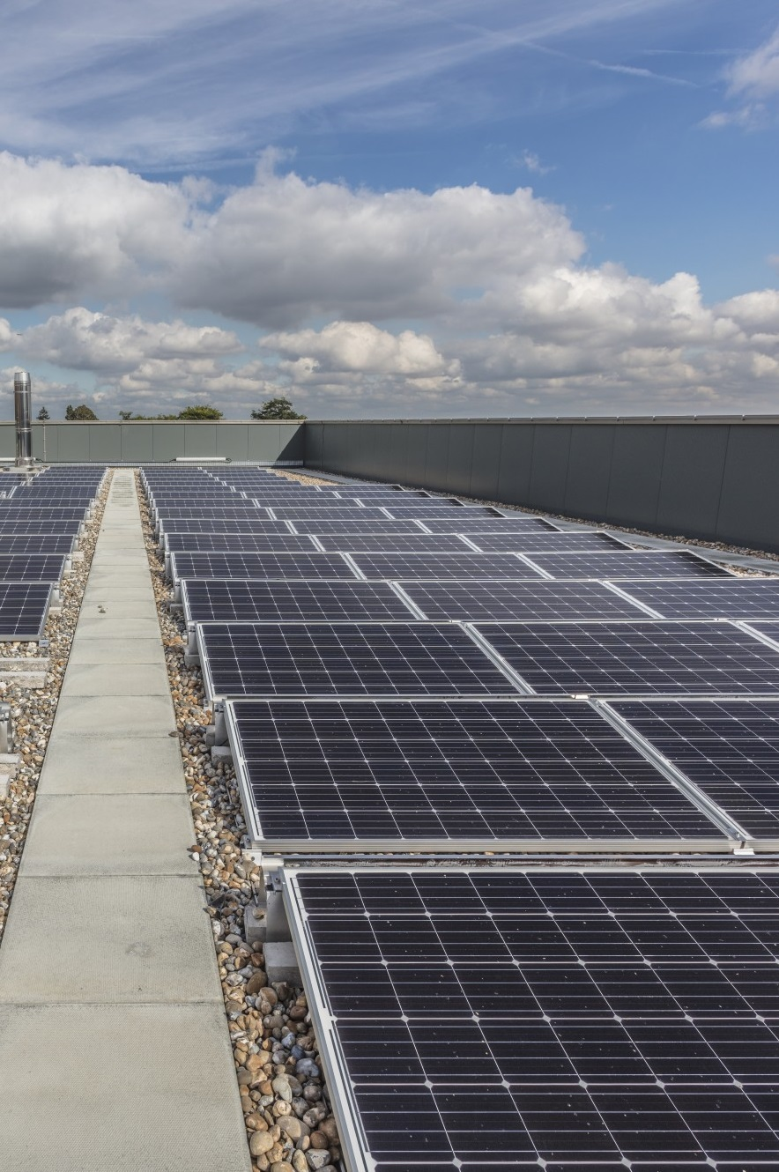

Slide 43
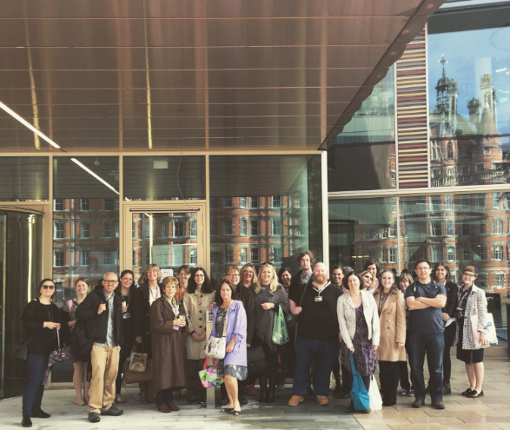

Slide 44
Timeline for Opening
Afternoon Friday 8th September – Ground floor handover to staff
Office move – Weekend 9th / 10th September
Staff move in – Monday 11th September
Ground floor open for users – Wednesday - Friday 10 am – 5pm
Fire safety approved – Friday 15th September 5:30pm
Open 24/7 - Saturday 16th September 9am
First arrivals day – Saturday 16th September

Slide 45
Notes:
Talk about spaces,
Tours – all users new students

Slide 46
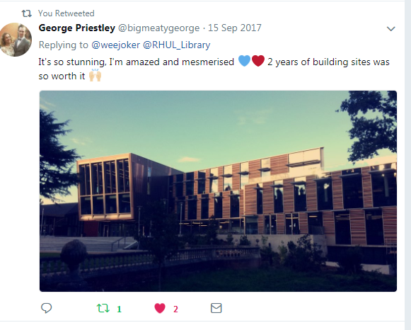

Slide 47
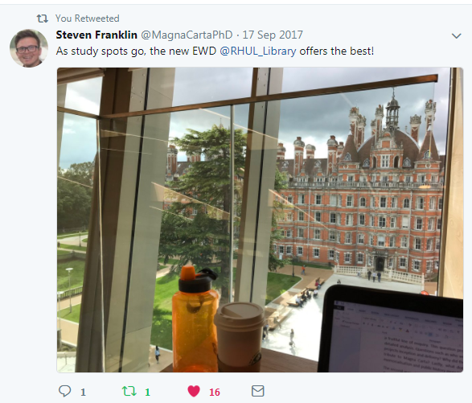

Slide 49
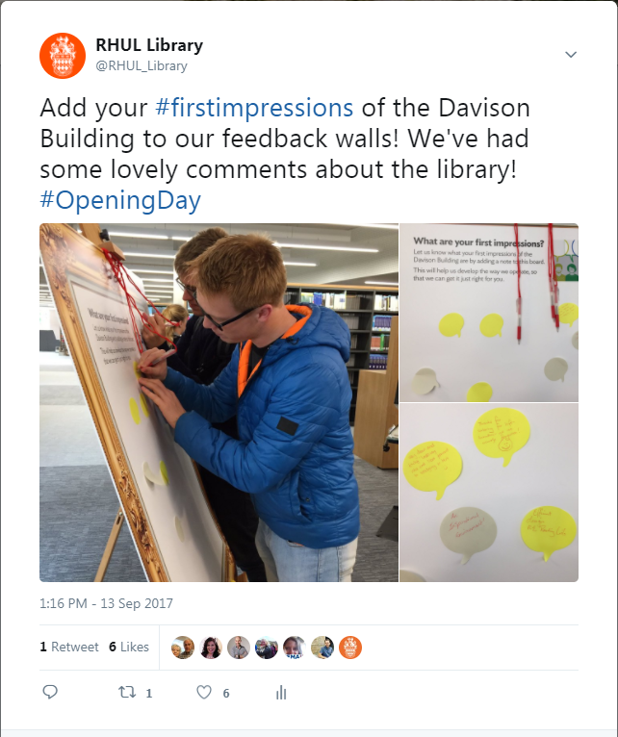

Slide 51
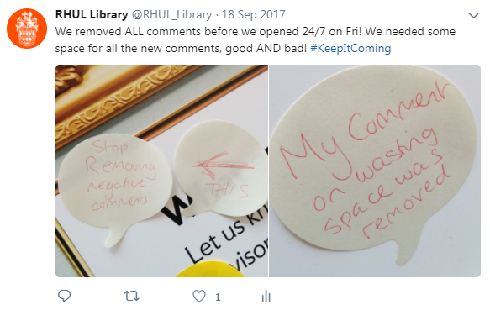

Slide 52
Still a building site…
Tuesday 3.10.17 - The engineers from Waverley Blinds will be working on the feature window blinds on level 2, with a tower scaffold. They will also be repairing a blind in the Café on the Square area. They will be in from 0630.
o Is the work on the first floor or second? 2nd
o Will any areas be closed as a result? Access to comfy seating will be impacted as the tower will be in that area – study desks will be accessible.
o Will the work be noisy or dusty? No
o What time do we hope that they will be finished by? 3-4 hrs – mainly due to reprogramming work.
·

Slide 53
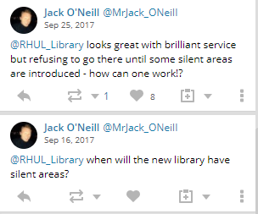
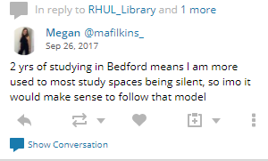
Zoning
Notes:
Tweets – 10 tweets mentioning silent, 5 students (and 1 alumni)
Also emails but most from same group of students
But they were also going to Staff Student Committees, talking to departments.
Academic staff up in arms but hadn’t visited
Offered everyone a meeting and a visit

Slide 55
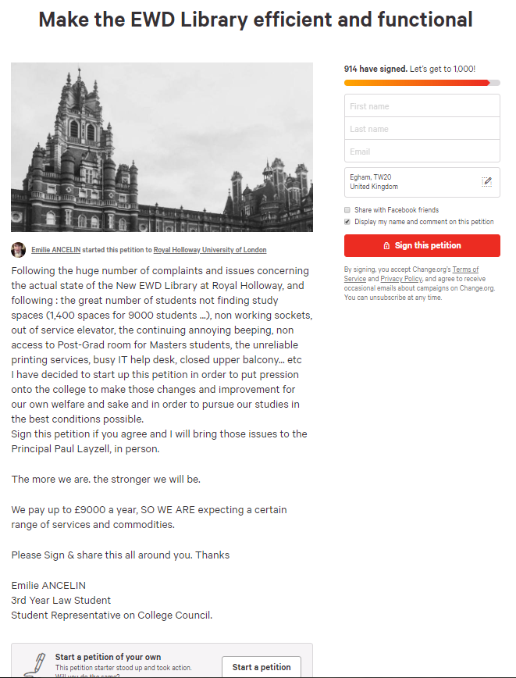

Slide 56
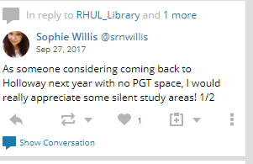
Audience

Slide 58
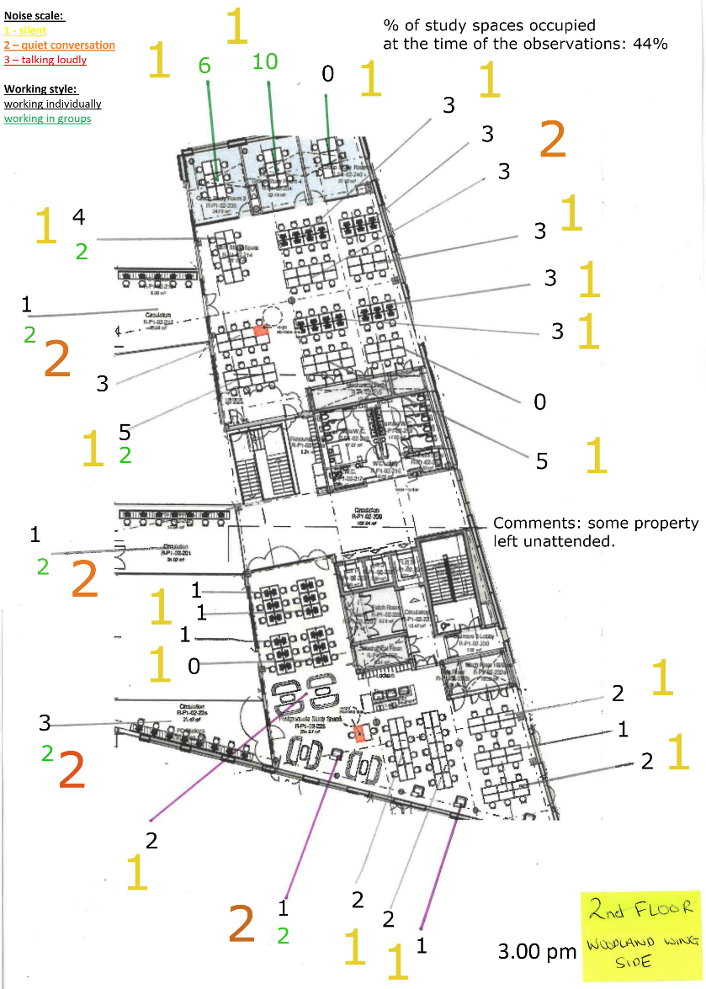
Behaviour mapping

Slide 59
User Experience
The observations took place from Monday 13th November to Sunday 19th November 2017 at 11am, 3pm and 7pm each day. They looked at noise and use of the space. The findings reflected the expected use of the space the division between those students who prefer silent study to group study.

Slide 60
Future UX plans
Summer Term 2018:
Touchtone tours and Cognitive maps;
To understand how our library users view and use the Library;
We will especially encourage students registered with the Disability and Dyslexia Services, as well as International students to take part;
These activities will be repeated in the next academic year.

Slide 61
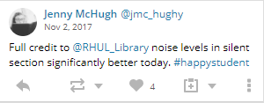

Slide 62
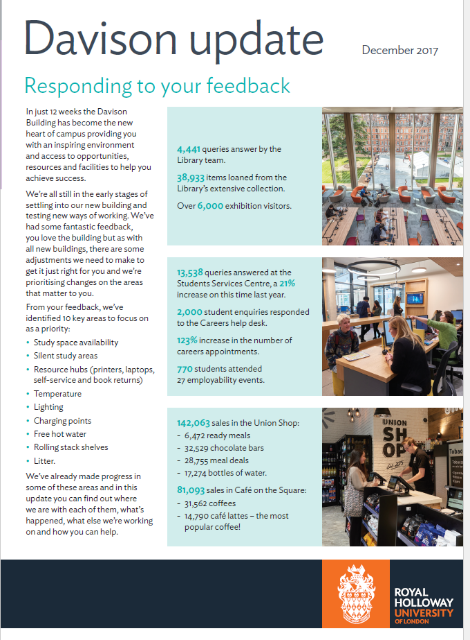

Slide 64
Extra Study Spaces
Notes:
110 study spaces added February 2018
Xmas electricity / IT
Sofas moved – temp desks in over xmas

Slide 65
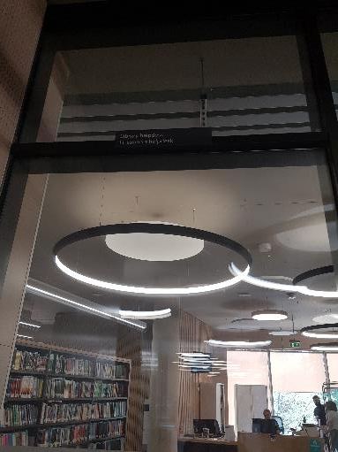
Signage
Notes:
Architect specified signage – wrong as shown here
Separate package for behavioural messages - reviewing over the summer

Slide 66
IT helpdesk

Slide 67
Questions?

