Slide 1
Is that research data in your pocket or are you just pleased to see me?
RDM at Goldsmiths

Slide 2
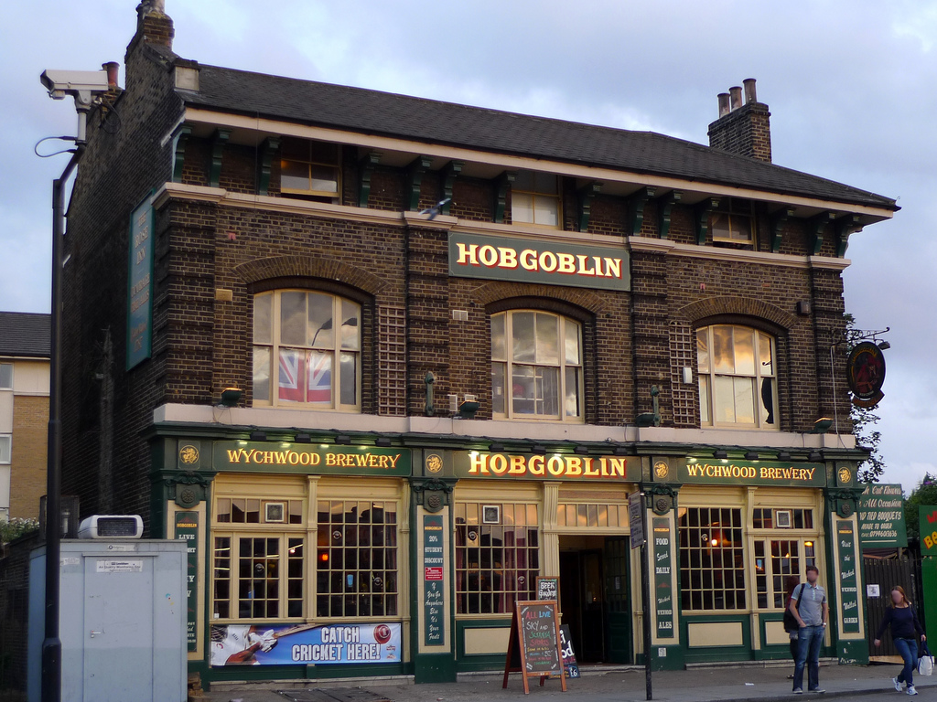

Slide 3
Goldsmiths
18 departments (AHSS with a bit of science)
Interdisciplinary
ESRC main funder
REF2014 ‘almost 3 quarters 3*or 4*’
14581 items in Goldsmiths Research Online GRO
5 items in Goldsmiths Data Online
4 Services/Repositories (Research/Data/Journals/Archives)
3 staff = 1.5 FTE + Me
Part of Kaptur project – RDM in visual arts

Slide 4
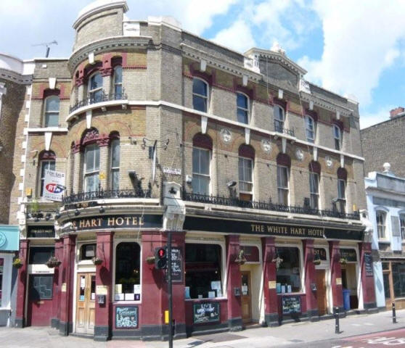

Slide 5
Current situation
Very little research data identified
Contact all RCUK funded researchers
DMP support at Research office
Final data GRO team
Restructures in research office – new data officer
Online support/Information on RDM not provided
RDM Statement online as part of records management policy http://www.gold.ac.uk/media/documents-by-section/about-us/governance/policies/records-management-policy.pdf

Slide 6
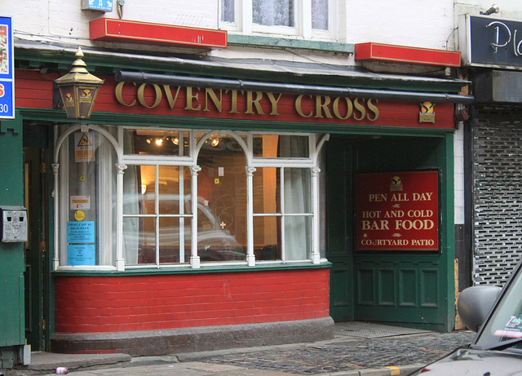

Slide 7
Barriers/Issues
REF/HEFCE/OA focus
Staffing resources
Research support mainly within GRO/Myself
Lack of confidence in library subject team
Student experience focus
Practice research
Research output vs research data
A service that is not requested

Slide 8
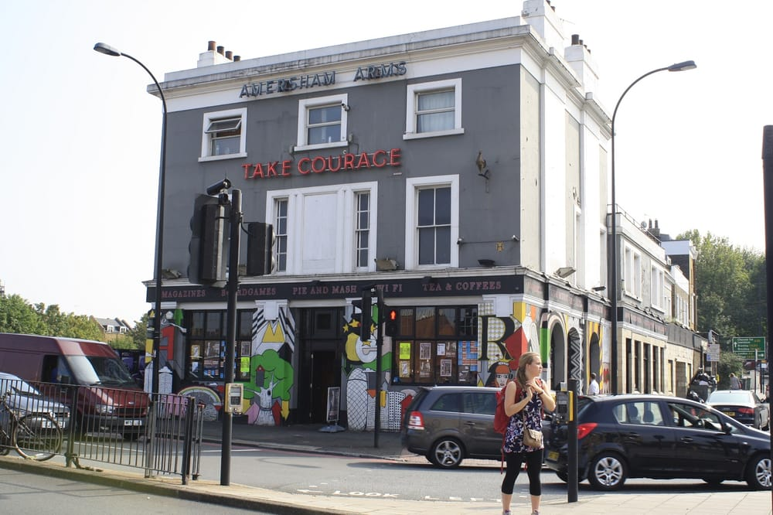

Slide 9
Who wants it?
Funders
Natural progression from OA for outputs
Compliance – a dirty hated word?
PhD students requested training
Sharing is still a problem – desire and resource

Slide 10
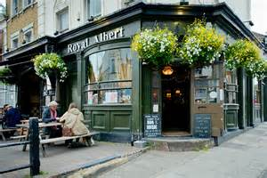

Slide 11
What can we practically offer?
Need to be part of current research practice not an ‘enforcer’
Advice/Support on managing digital material ‘stuff’
File formats, file sizes, file naming conventions, storage, back up, annotation, anonymisation, ethics
Create a record/registry (at least we know it exists)
Conversations on ‘sharing’ later

Slide 12
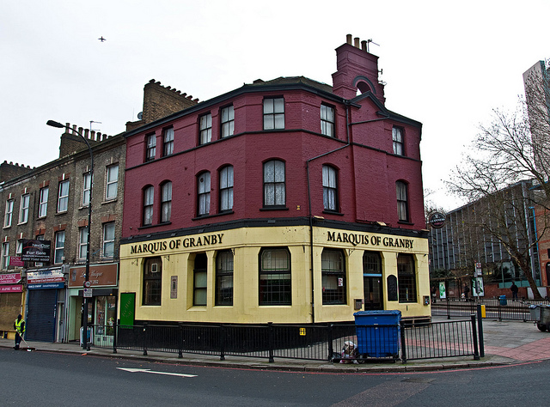

Slide 13
LEARN Case Study
Practice research project
Complex/multimedia/multi output project
Series of installations in forests across UK
Sound/Music responding to the natural environment/weather
GRO team member/PhD student/Practising artist

Slide 14
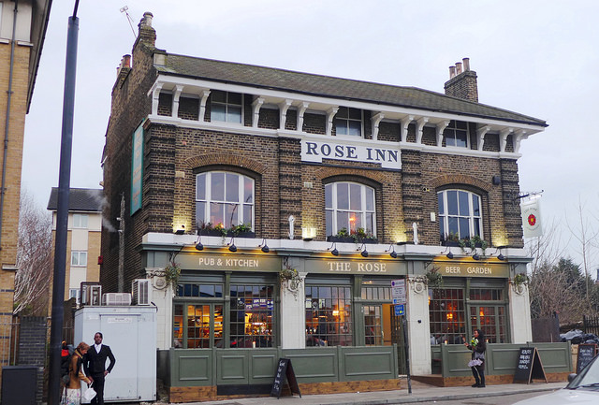

Slide 15
Living Symphonies https://vimeo.com/111858776
a landscape sound installation by James Bulley and Daniel Jones, which toured across four different forests in the UK in the summer of 2014. The work portrays the thriving activity of the forest's wildlife, plants and atmospheric conditions, creating an ever-changing sound symphony heard from a network of 24 speakers hidden throughout the forest itself. Working with ecologists and wildlife experts across the United UK, Jones/Bulley developed highly detailed maps of the flora and fauna that inhabited each forest site where the installation was to take place

Slide 16
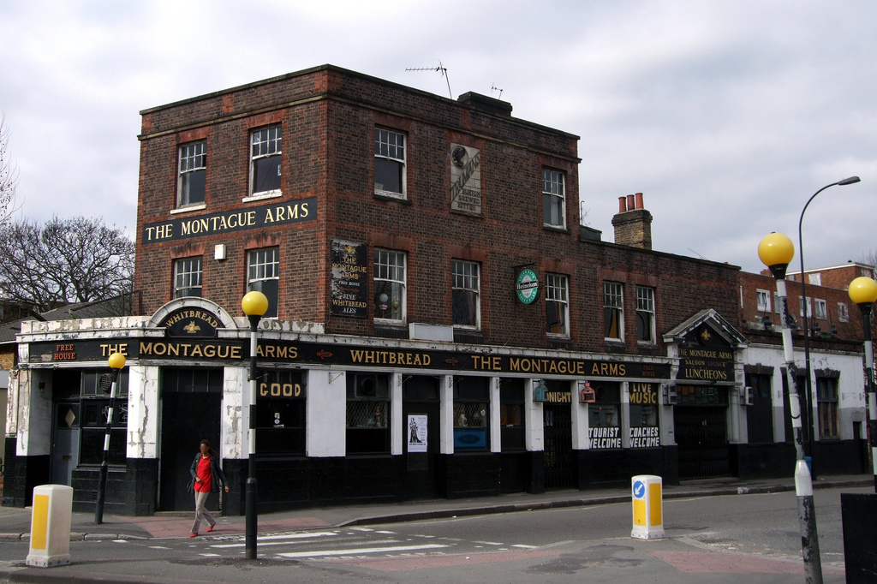

Slide 17
Living Symphonies Data
Year long data collection
Survey data : Ecological surveys, photographic surveys, illustrations of organisms, field recordings of forest/birds, site documentation, musical recordings with musicians, software simulations of forest,
Ancillary data: written testimonials, press coverage, video/audio/photographic documentation of sites while live, captures of weather data
Formats/Tools: excel spreadsheets, google docs/drive, dropbox, adobe illustrator, ableton live, pro tools, HD film, photoshop, DSL cameras, professional microphones, python, C++, paper, paparazzi screen capture, pdf conversion tools, custom weather capture software, hard drives, ipads
Multiple creators: artists, volunteers, project crew, commissioned artists, visitors, local environmental groups, environmental researchers
Back Up/Storage: Dropbox, hard drives
Sharing: via project website

Slide 18
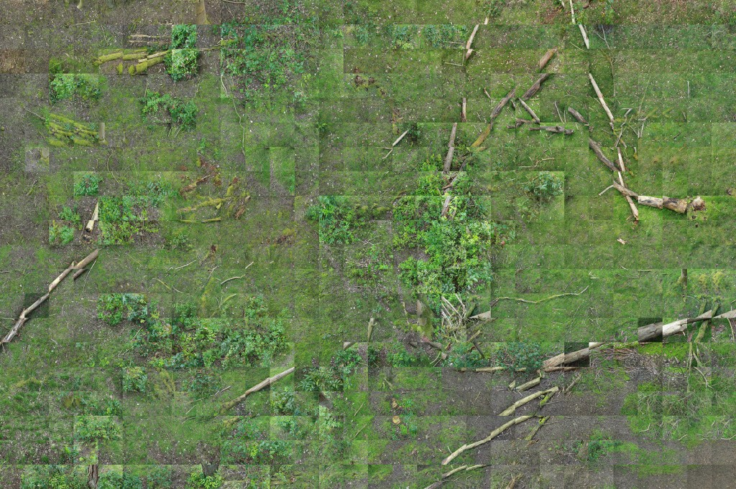

Slide 19
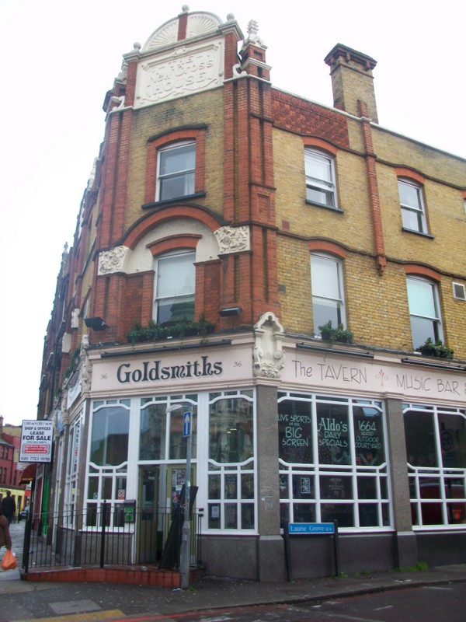

Slide 20
Plans/Future/wishlist
Focus on our practical knowledge strengths
Integrated approach with new data officer/IT
Online information
Library subject team training
Specific guide on practice research (working on that now)
Target specific departments e.g. Sociology, Psychology, Design and Graduate School (PhDs)
New staff?
Small project on data analytics w Library Systems Team (direct experience of managing data e.g. anonymisation)
Using datasets – TDM
Clarify the advantages of RDM as a service for Institution e.g. REF environment section

Slide 21
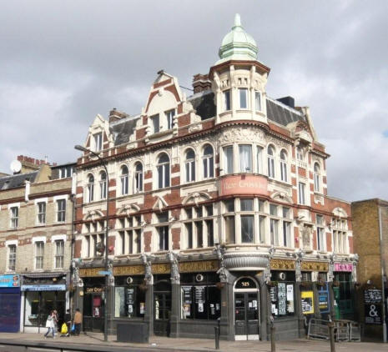

Slide 22
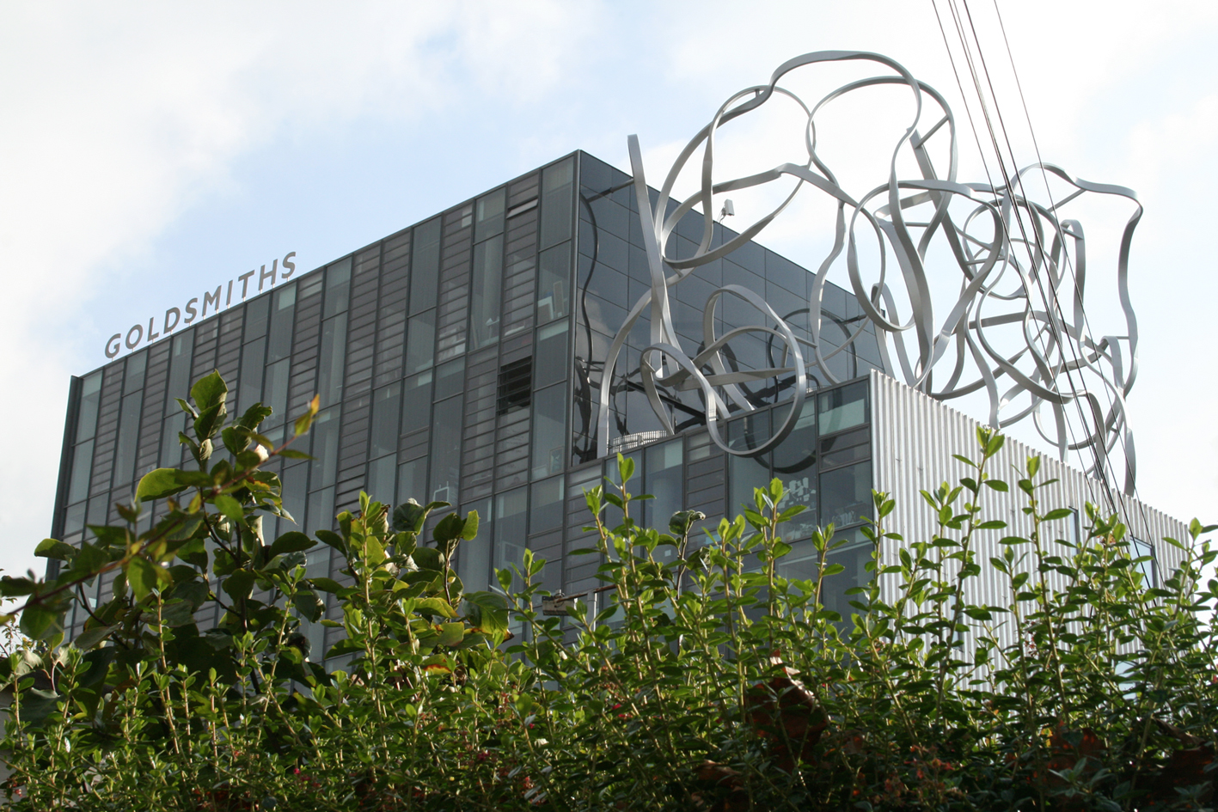
Andrew Gray a.gray@gold.ac.uk
020 7919 7161

