Slide 1
Research data management at UAL
Jeremy Barraud, Deputy Director, Research Management and Administration
Jess Crilly, Associate Director, Content & Discovery, Library Services

Slide 2
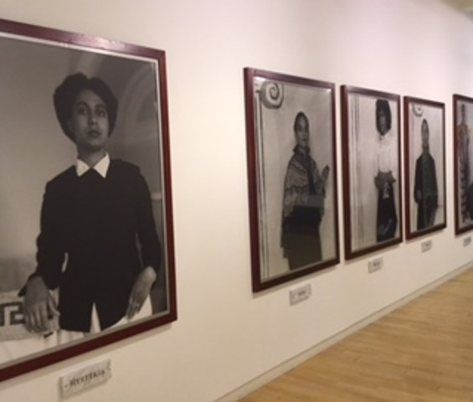
About UAL
Largest arts and design university in Europe
Central Saint Martins; London College of Communication; London College of Fashion; Camberwell, Chelsea, and Wimbledon Colleges of Arts
Top 30 UK research institutions for the quality of research submitted in the REF 2014
Theory and practice-based research

Slide 3
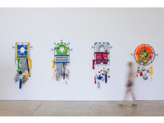
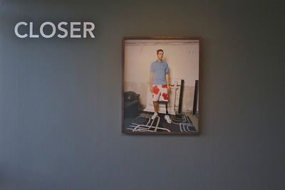
…RDM in the arts?
Research outputs
The Kultur project
Research data
The Kaptur project
DCC institutional engagement
Scholarly communications infrastructure

Slide 4
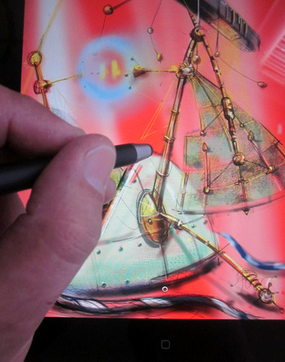
RDM Policy
RCUK Seven common principles
Aims and Principles of good RDM
Roles and responsibilities
Appendix A: Workflows
Scope:
Generally, research data can be considered anything created,
captured or collected as an output of funded research work
in its original state.

Slide 5
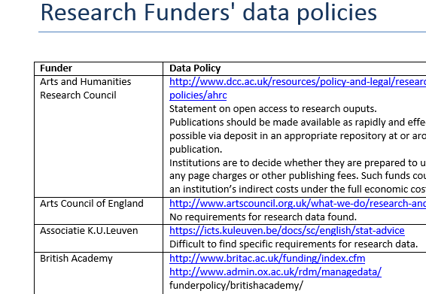
Funder requirements

Slide 6
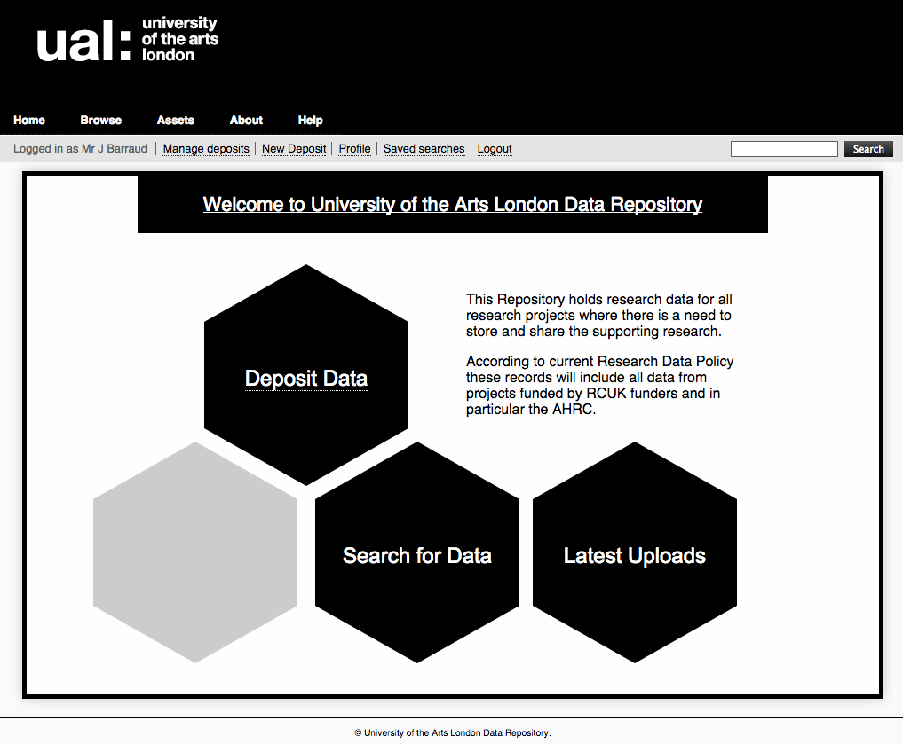

Slide 7
Data management planning
Established workflow as part of Data Management Policy
Workflow covers, pre-award, post-award and post-project stages
Bespoke support for each application

Slide 8
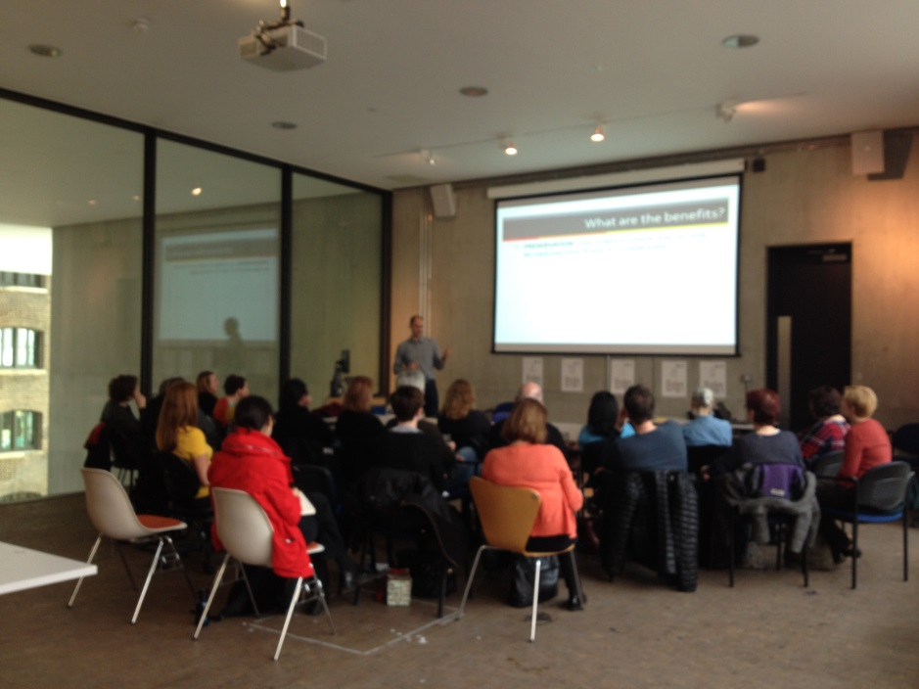
Community of Practice
Share and disseminate expertise and skills between colleagues across a whole range of subject and professional disciplines
Introduction to data management
Case studies
Metadata discovery
File formats

Slide 9
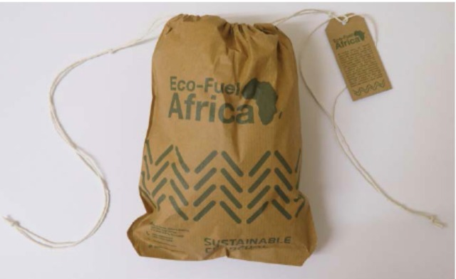
What we’ve done
Research and exploration of arts research data management
UAL Research Data Management
Policy
UAL Data Repository
Data management planning

Slide 10
Challenges of practice
Embedding RDM into everyday business – impact on CRIS, digital asset management
Storage
Balance between academic and professional practice
Learning by doing – academics, research support staff, IT staff; participation in Jisc Research Data Spring
Monitoring sector developments

